Slide 1
Wednesday, 02 February 2022
Teeth and their functions

Slide 2
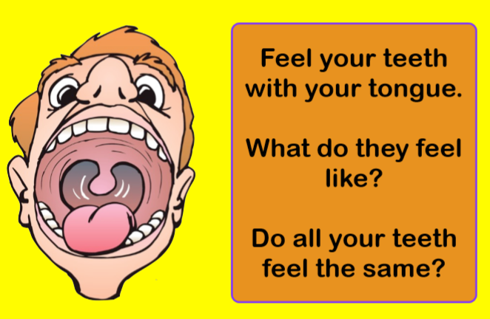

Slide 3
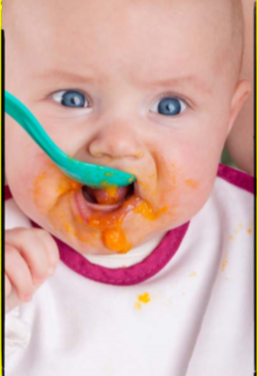
We have teeth to help us eat. Teeth help us to cut and chew food to break it down so we can swallow it easily and start digesting it. Without teeth, all your food would have to be very mushy for you to be able to eat it! That is why baby food is soft - babies do not have teeth to chew their food so it has to be mushy.

Slide 4
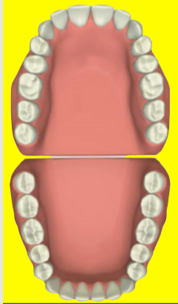

Do all teeth look the same??
What are the differences between the different types of teeth?

Slide 5
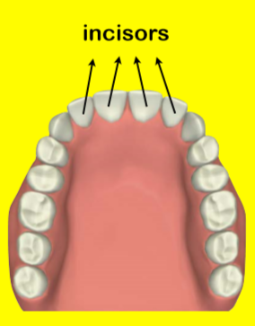
Incisors
The teeth at the front of your mouth are called INCISORS. Incisors are used for biting and cutting food. Incisors are flat and have smooth edges

Slide 6
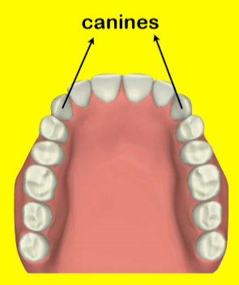
Canines
Next to your incisors are the CANINES. Canine teeth are sometimes known as eye teeth. Canines are used for tearing and ripping food. Canines are pointy and sharp.

Slide 7
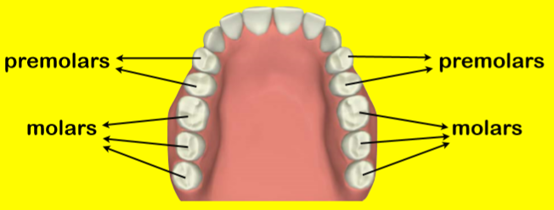
Molars
The teeth at the back of your mouth are called MOLARS. In adult mouths, the two teeth next to the canines are called premolars and the three teeth at the back of the mouth are molars. Children do not have premolars. Molars are bigger than the other teeth and have a flat surface for chewing and grinding food.

Slide 8
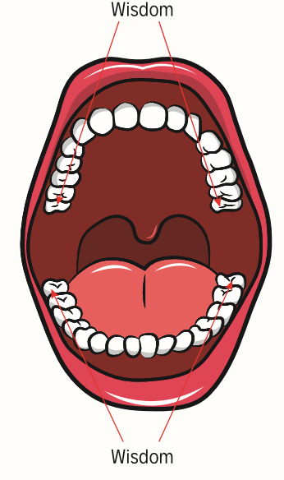
Wisdom
When we get older, most of us will grow our wisdom teeth. We have 4 wisdom teeth. Our wisdom teeth are basically an extra molar so help with grinding our food.

Slide 9
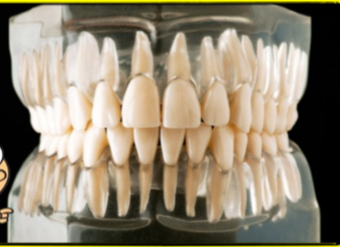
Roots
Teeth have roots that hold the teeth in place in the gums. If you feel your gums, you can feel the root of your teeth. It is important to care for your gums as well as your teeth so that your whole mouth stays healthy.
This picture shows how teeth are set in the gums and shows what your mouth would look like if your gums were clear.

Slide 10
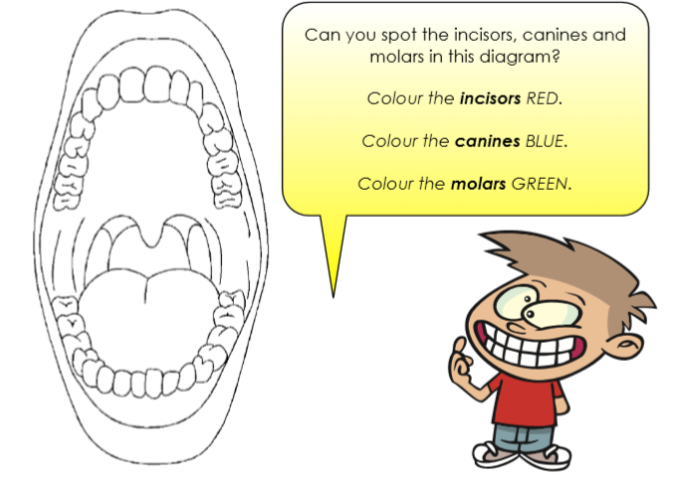

Slide 11
Did you know?
Adults have 32 teeth whilst children only have 20!

Slide 12
Task:
Present the information about teeth – include the different types of teeth and their functions (how they are used)
Add any fun facts and illustrations to make your work creative!

