Slide 2

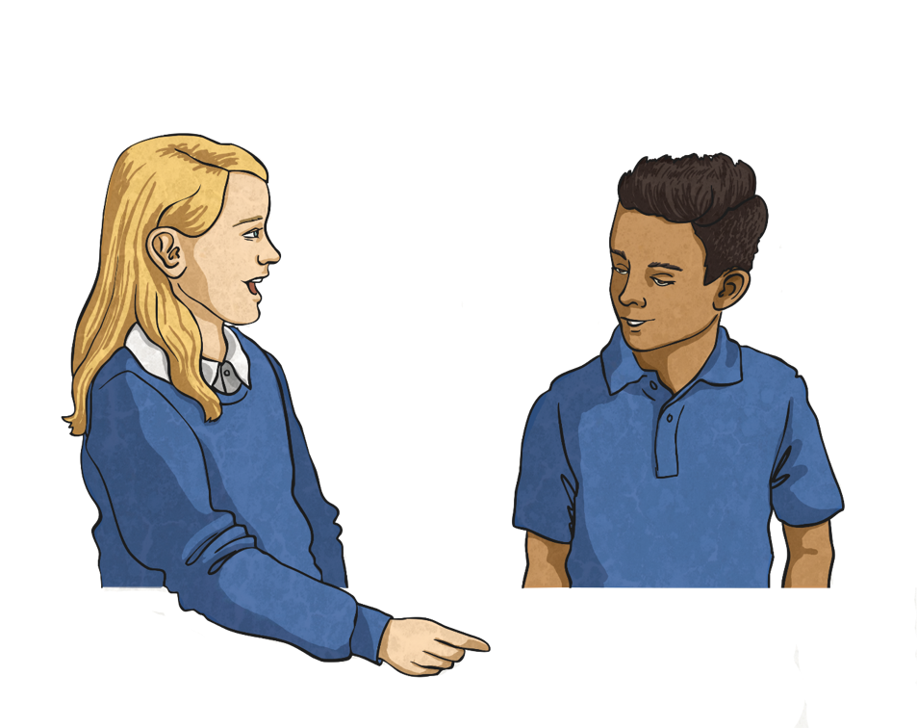
What’s It All About?
Outside, we can encounter many different hazards
or dangers.
We will share your ideas and then come back to them at the
end of the lesson to see what we can add.
Brainstorm – what dangers might you encounter?

Slide 3

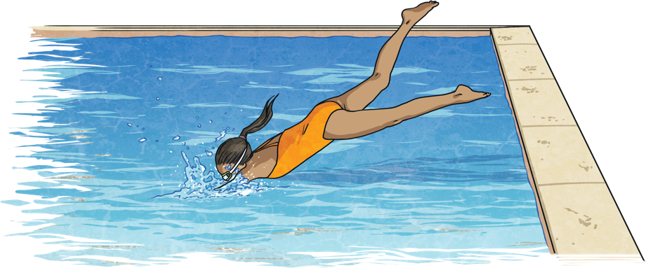
Be Water Aware
There are different places in our local environment where we may be near or even in water. There are many ways we can stay safe in any kind of area with water.
Learning to swim is one of the most important ways to stay safe in water. Some people find this trickier than others but making sure you can stand up in the depth of water and using armbands, floats or other aids to help you in the water can help you stay safe.

Slide 4
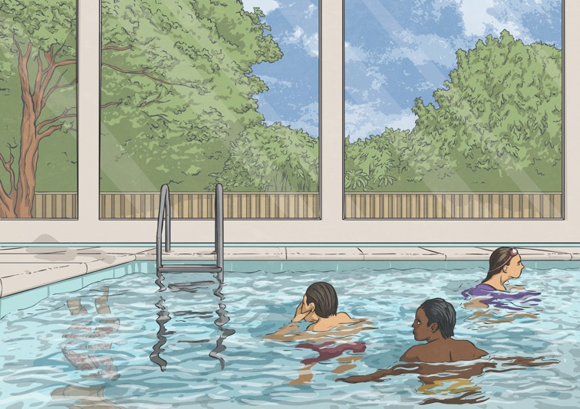
Be Water Aware
Swimming pools can be a safe place to swim as there are
lifeguards to keep us safe.
Always follow the safety tips on the posters all around the pool, walk around the poolside to avoid slipping, only dive in where signs state it is safe to do so and always stay within your depth (where you can touch the bottom if you cannot
swim well).

Slide 5
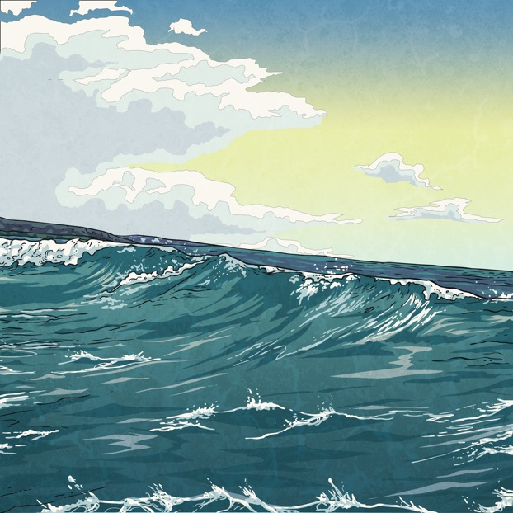
Be Water Aware
Swimming in the sea is best at a beach where there are lifeguards. Always stay within your depth in the sea and only go swimming with a trusted adult. Most beaches have posters displaying rules and flags that help you
stay safe.

Slide 6

Be Water Aware
Other bodies of water, such as rivers, lakes, canals, ponds and reservoirs are generally not best for swimming unless they are signposted safe or an adult tells you it is OK to swim.
Always follow rules on warning and safety signs, stay out of fast-flowing water, avoid water that is too cold and get out of the water if you feel cold. Always wear a life jacket if you are doing a water-based activity, such as canoeing or sailing.

Slide 7
Task – Create a safety poster
Be water aware:
Learn to swim
Follow safety posters and signs
Stay within depth
Don’t swim in lakes, rivers or canals
Never dive or jump into unknown water
Children should always have an adult present
Don’t swim in the ocean when red warning flags are out
Wear a life jacket for water-based sports

