Slide 1

Read
Stone Age Boy
Satoshi Kitamura
Video link =
https://www.youtube.com/watch?v=aqy5ENpagts

Slide 2

Rapid Retrieval
What is the girl’s name?
What tool did the men use to fish?
Which animal did they catch and eat?
How did she light the torch?
How did the boy know it wasn’t a dream after all?

Slide 3
Rapid Retrieval - ANSWERS
Om
Spears
reindeer
Struck flint together
See’s a picture of him in a cave painting.

Slide 4
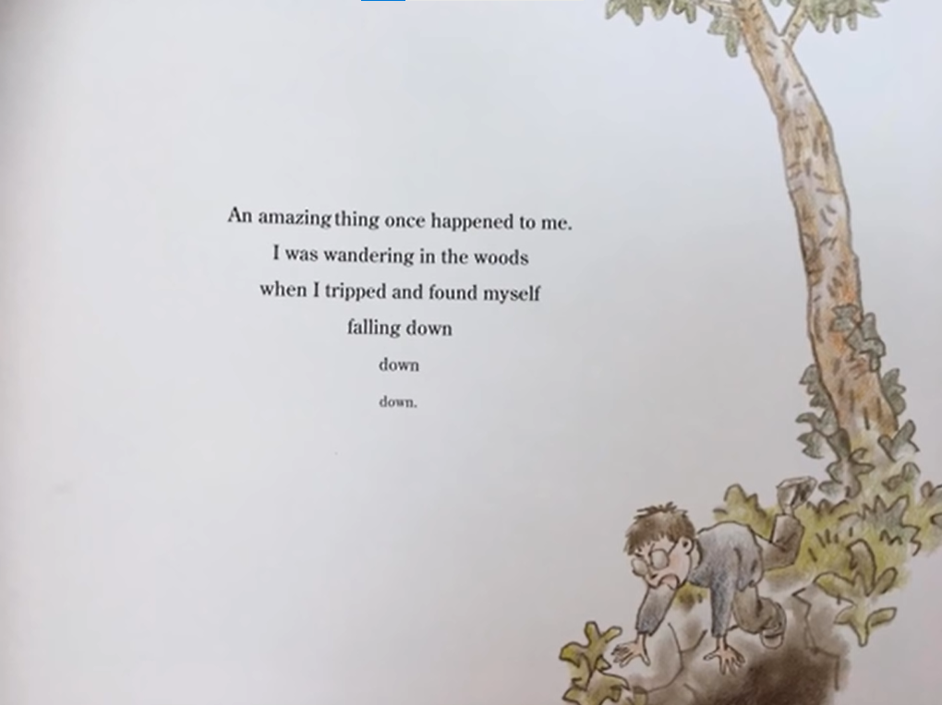

1) Why is ‘down down down’ is set out like this?

Slide 5

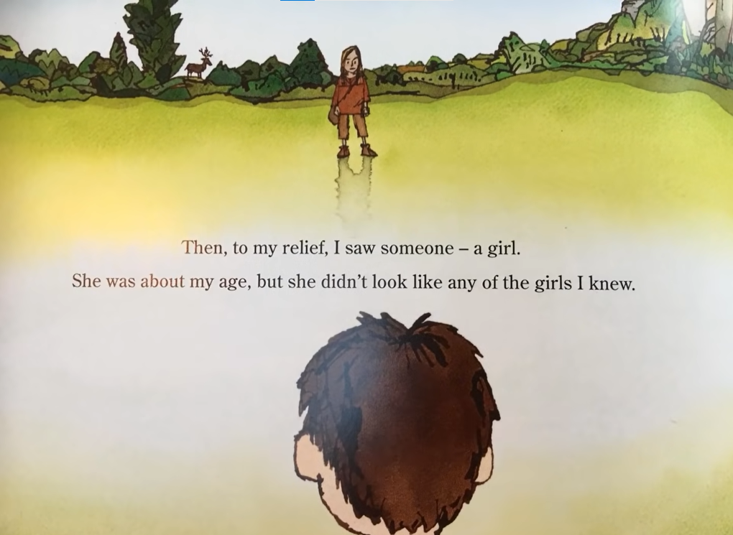
2) Why do you think the boy was relieved when he saw someone?

Slide 6
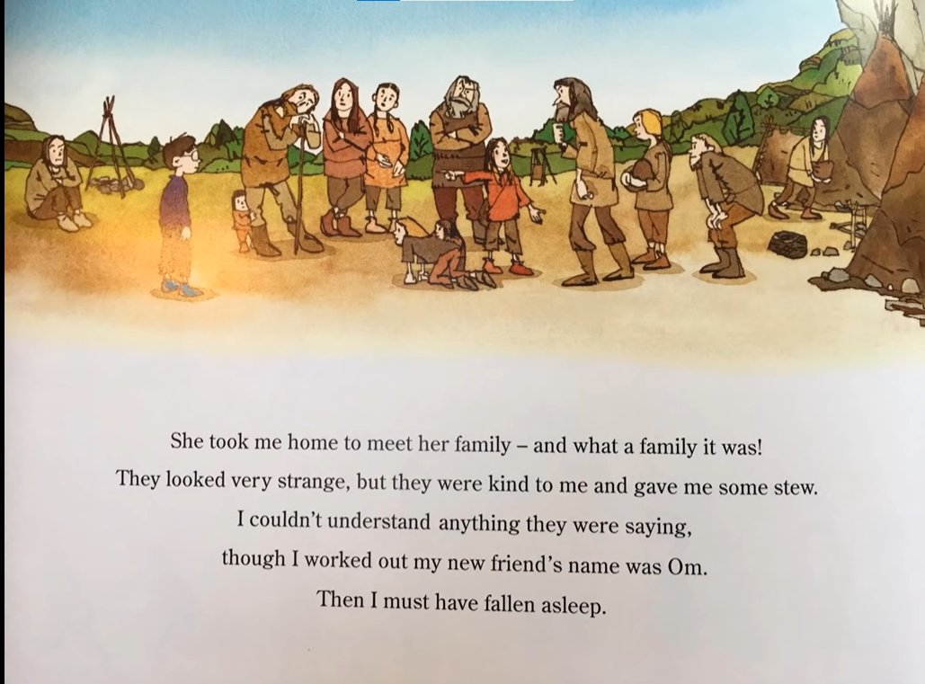
3) Why can’t the boy understand the family?

Slide 7
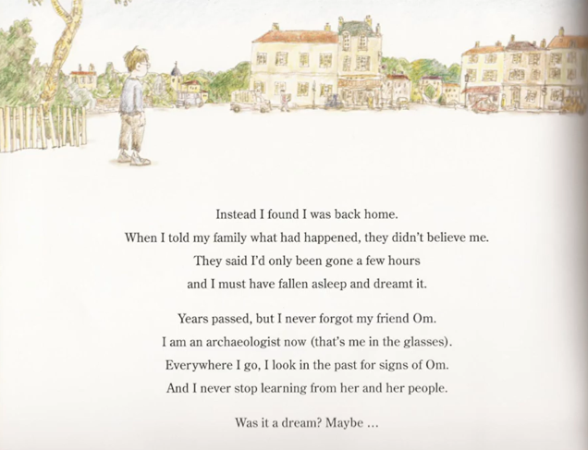
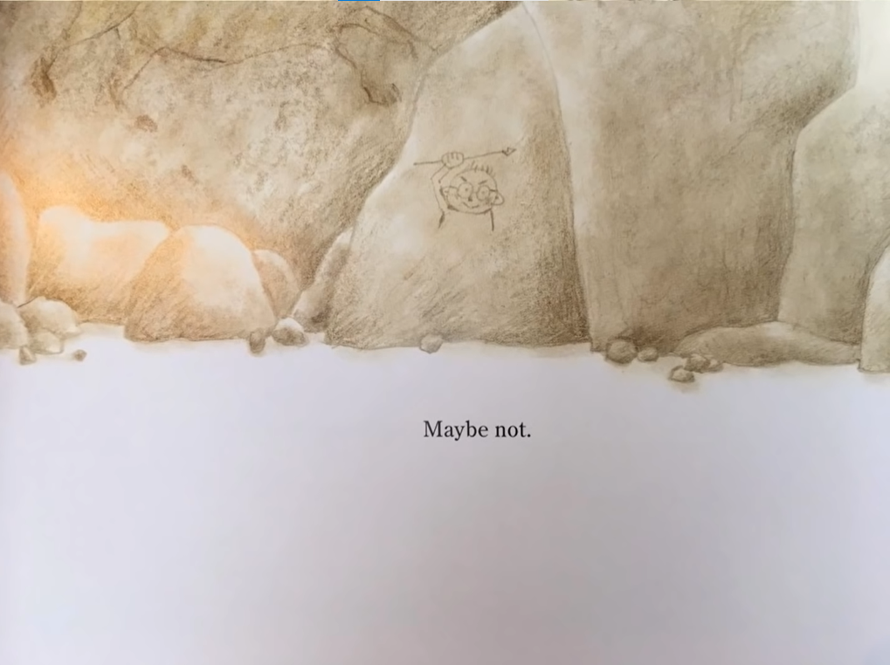
4) Why don’t the boy’s family believe him when he returns from his adventure?
.
5) Do you think the boy was dreaming? Yes, no, maybe? Why? Why not?

