Slide 1
Lava Lake
Lava Lake Found on Frozen Island Near Antarctica

Slide 2
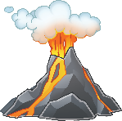


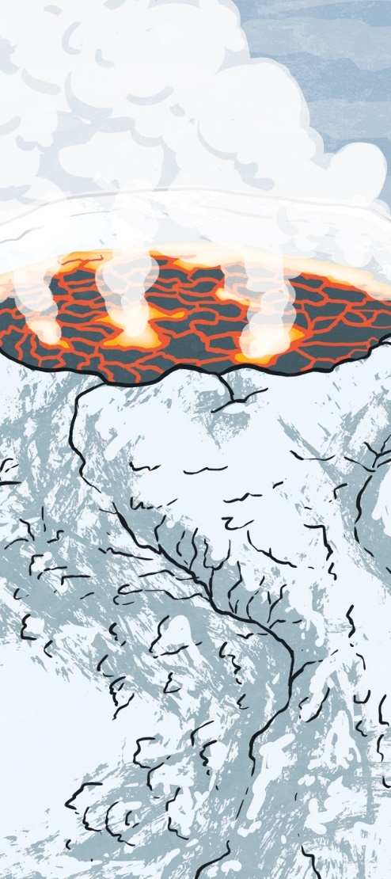
Daily News
Science x World News x
5th July 2019
Lava Lake Found on Frozen Island Near Antarctica
Scientists have found a rare lake of fiery lava in a rather unusual place — on a frozen island next to Antarctica!
The South Sandwich Islands are an incredibly cold group of tiny subantarctic islands. However, in the middle of one of these remote and icy islands, scientists have discovered a blazing lava lake!
The lava lake is incredibly rare — across the entire world there are only eight!
The molten lake is inside the volcano of Mount Michael on Saunders Island, one of the South Sandwich Islands.
For nearly 30 years, scientists have suspected that Mount Michael had a permanent lake of lava inside it; the volcano’s heat suggested a source of magma inside.
Scientists used satellite images to examine deep inside the volcano. There, they found clear evidence of a molten lava lake.
This discovery just shows how many wonders of the world we have yet to discover!
Read the full article online here.
Where are the South Sandwich Islands?
How are volcanoes formed?
What are tectonic plates?
Illustration: The lava lake on Mount Michael.
Notes:
Teacher Note - Please do not let the next video automatically play at the end of the clip. Please check the content in this link, including any comments, is suitable for your educational environment before showing. Twinkl accepts no responsibility for the content of third party websites.

Slide 3
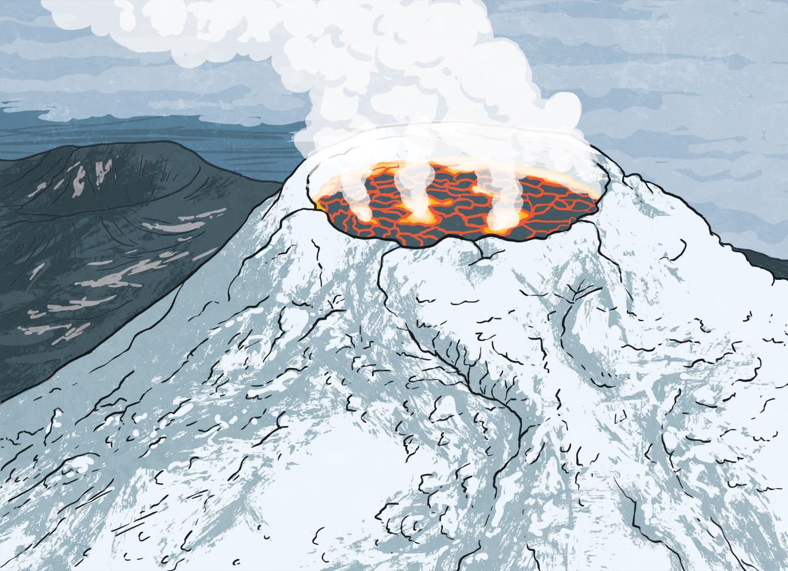

Slide 4


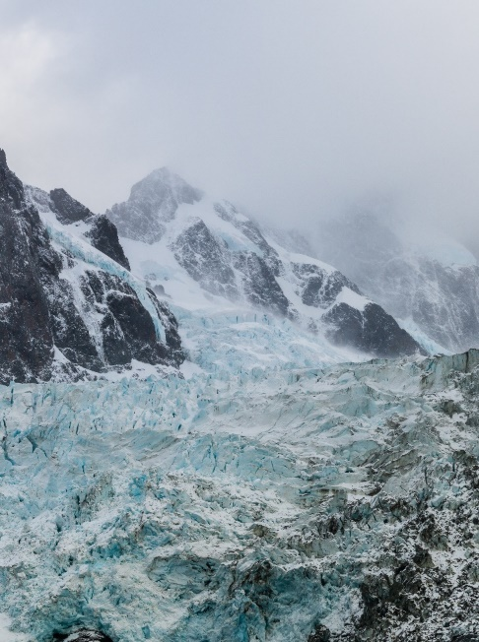
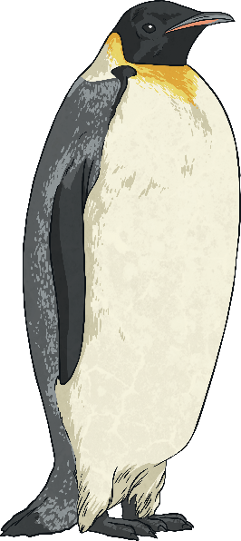

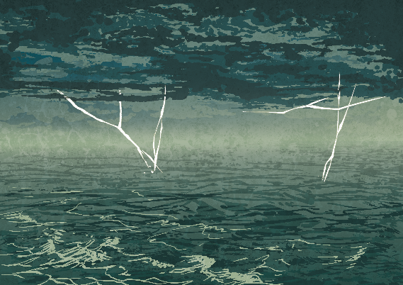

Where Are the South Sandwich Islands?
aggressive
environment
variety
The South Sandwich Islands are a group of islands in the southern Atlantic Ocean.
Many of the islands are either active volcanos or were formed by volcanos.
They are an amazing environment for wildlife! One of the islands is home to one of the world’s largest penguin colonies.
They are incredibly remote and have no permanent population.
As they are only around 1000 miles from Antarctica, it is very cold. The aggressive weather also makes it very difficult to reach the islands safely.
Find the South Sandwich Islands in an atlas or online map.
There are a huge variety of different species of seals and sea birds as well.
What do you think the landscape is like?

Slide 5
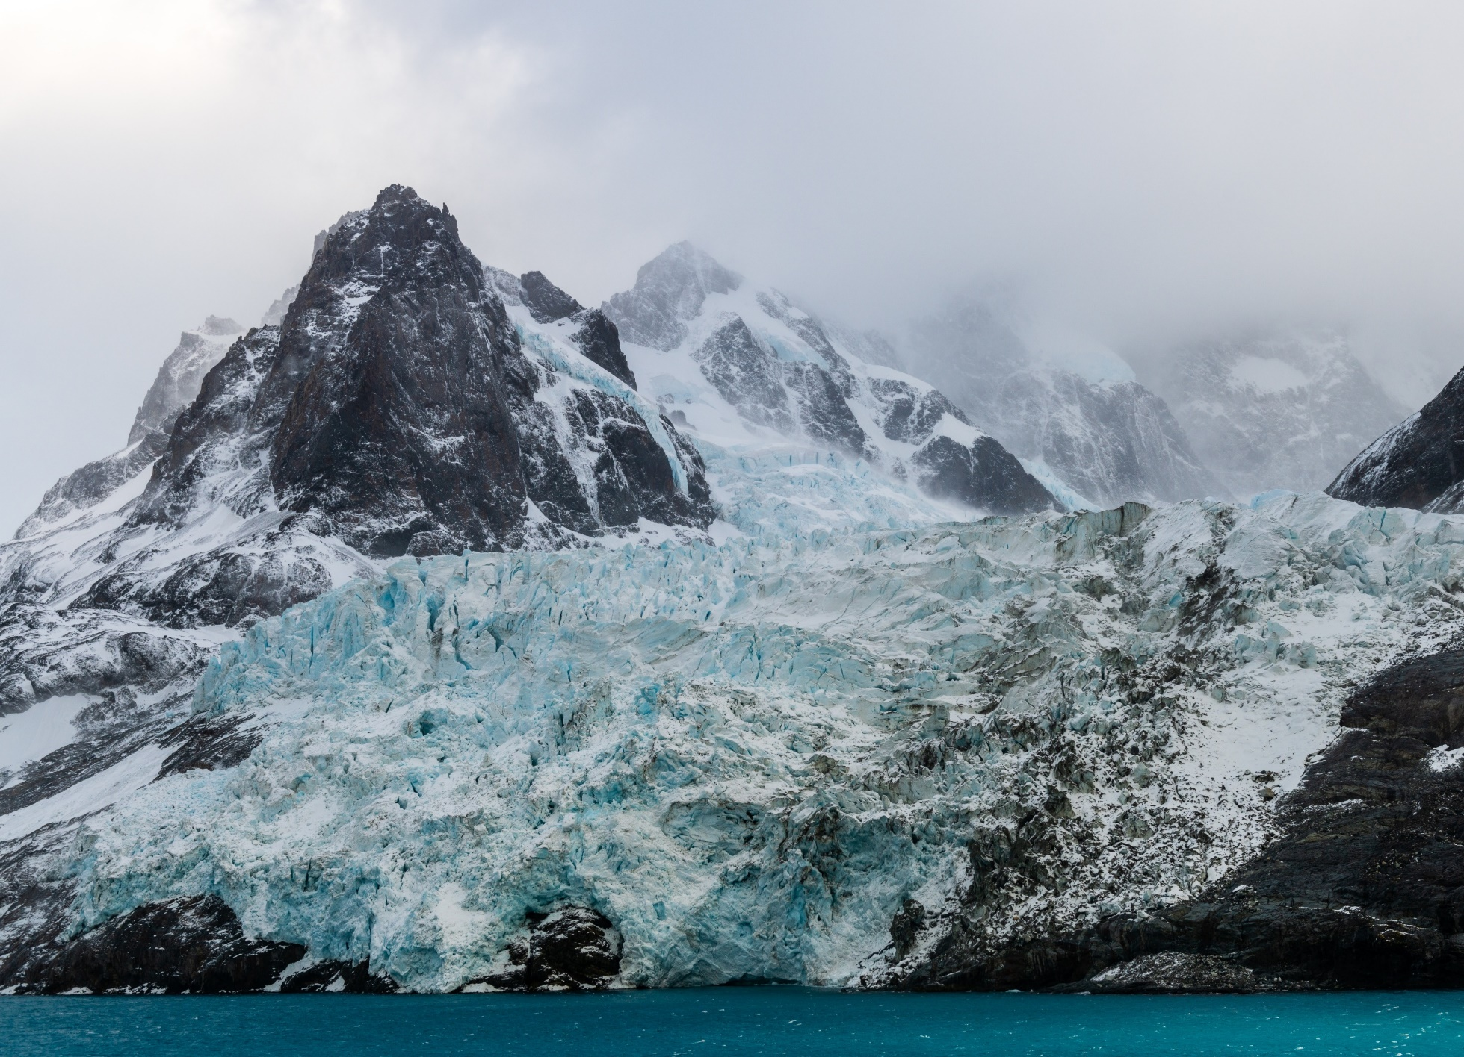

Slide 6
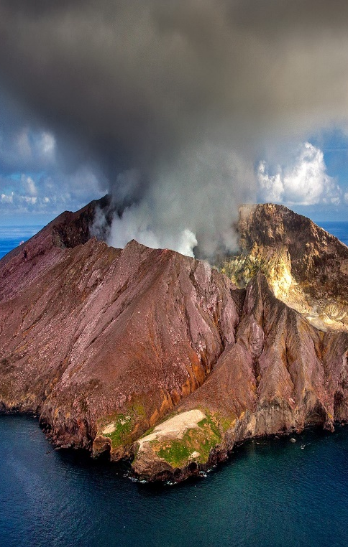
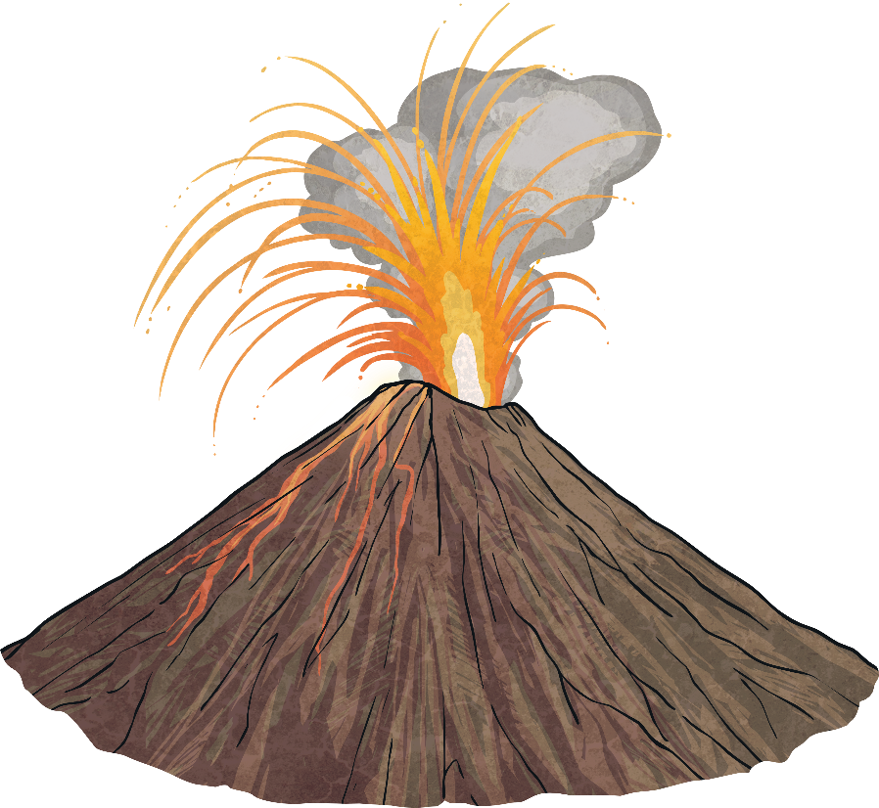

How Are Volcanoes Formed?
existence
temperature
categories
Volcanoes are mountains which have an opening in the Earth’s crust. There are over 1500 volcanoes in existence.
As the mantle moves, it creates pressure. This causes magma to leak onto the Earth’s surface, creating a volcano.
The Earth is made up of different layers. The outer layer is called the crust.
There are three categories of volcanoes: active, dormant and extinct.
Underneath the crust, it is incredibly hot. The temperature can range from 1000°C to 3700°C.
Active volcanoes are currently erupting or have erupted recently.
Summarise three facts about volcanoes.
Dormant volcanoes haven’t erupted in a long time while extinct volcanoes probably will never erupt again.
This heat melts rocks into magma. This is called the mantle.
Do you know any other volcanoes in the world?

Slide 7
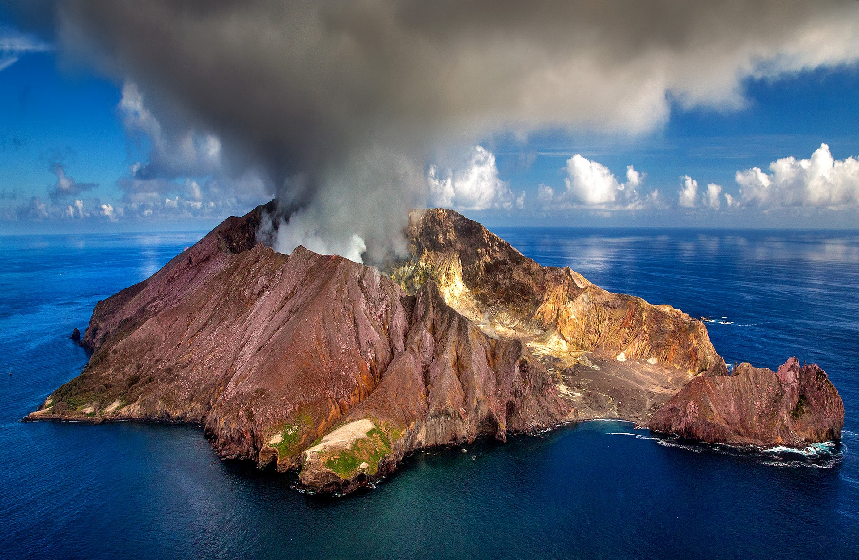

Slide 8
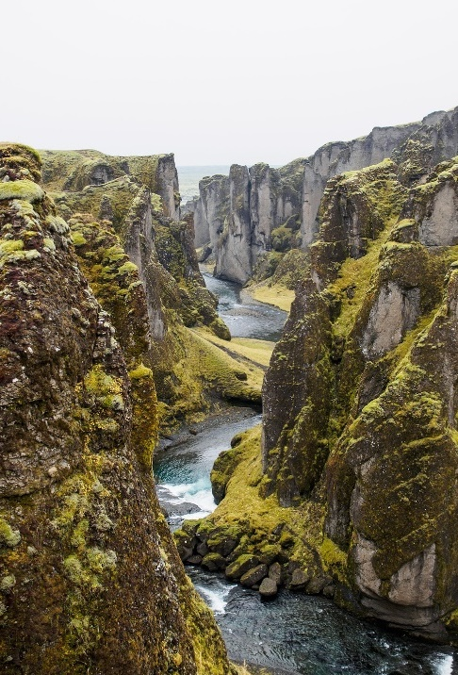
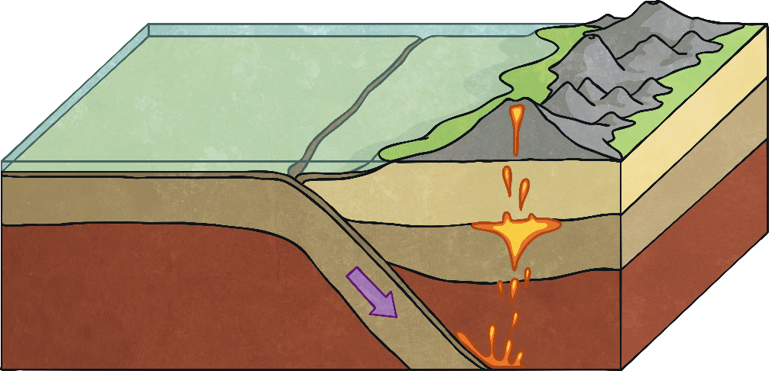

What Are Tectonic Plates?
frequently
physical
occur
Volcanoes, including Mount Michael on the South Sandwich Islands, frequently form on the boundaries of tectonic plates.
When plates push against each other, it can cause volcanoes to occur.
These are different sections of the Earth’s physical surface, called the crust. They are constantly moving about on the softer mantle.
Tectonic plates moving can also create earthquakes.
Find out more about the tectonic plates.
250 million years ago, the Earth was one large landmass. As the tectonic plates have shifted, they’ve formed the different continents we see today!
As these plates move around, they can collide, rub against each other or even move away.
Look at an atlas or map. Which continents do you think once fitted together?

Slide 9
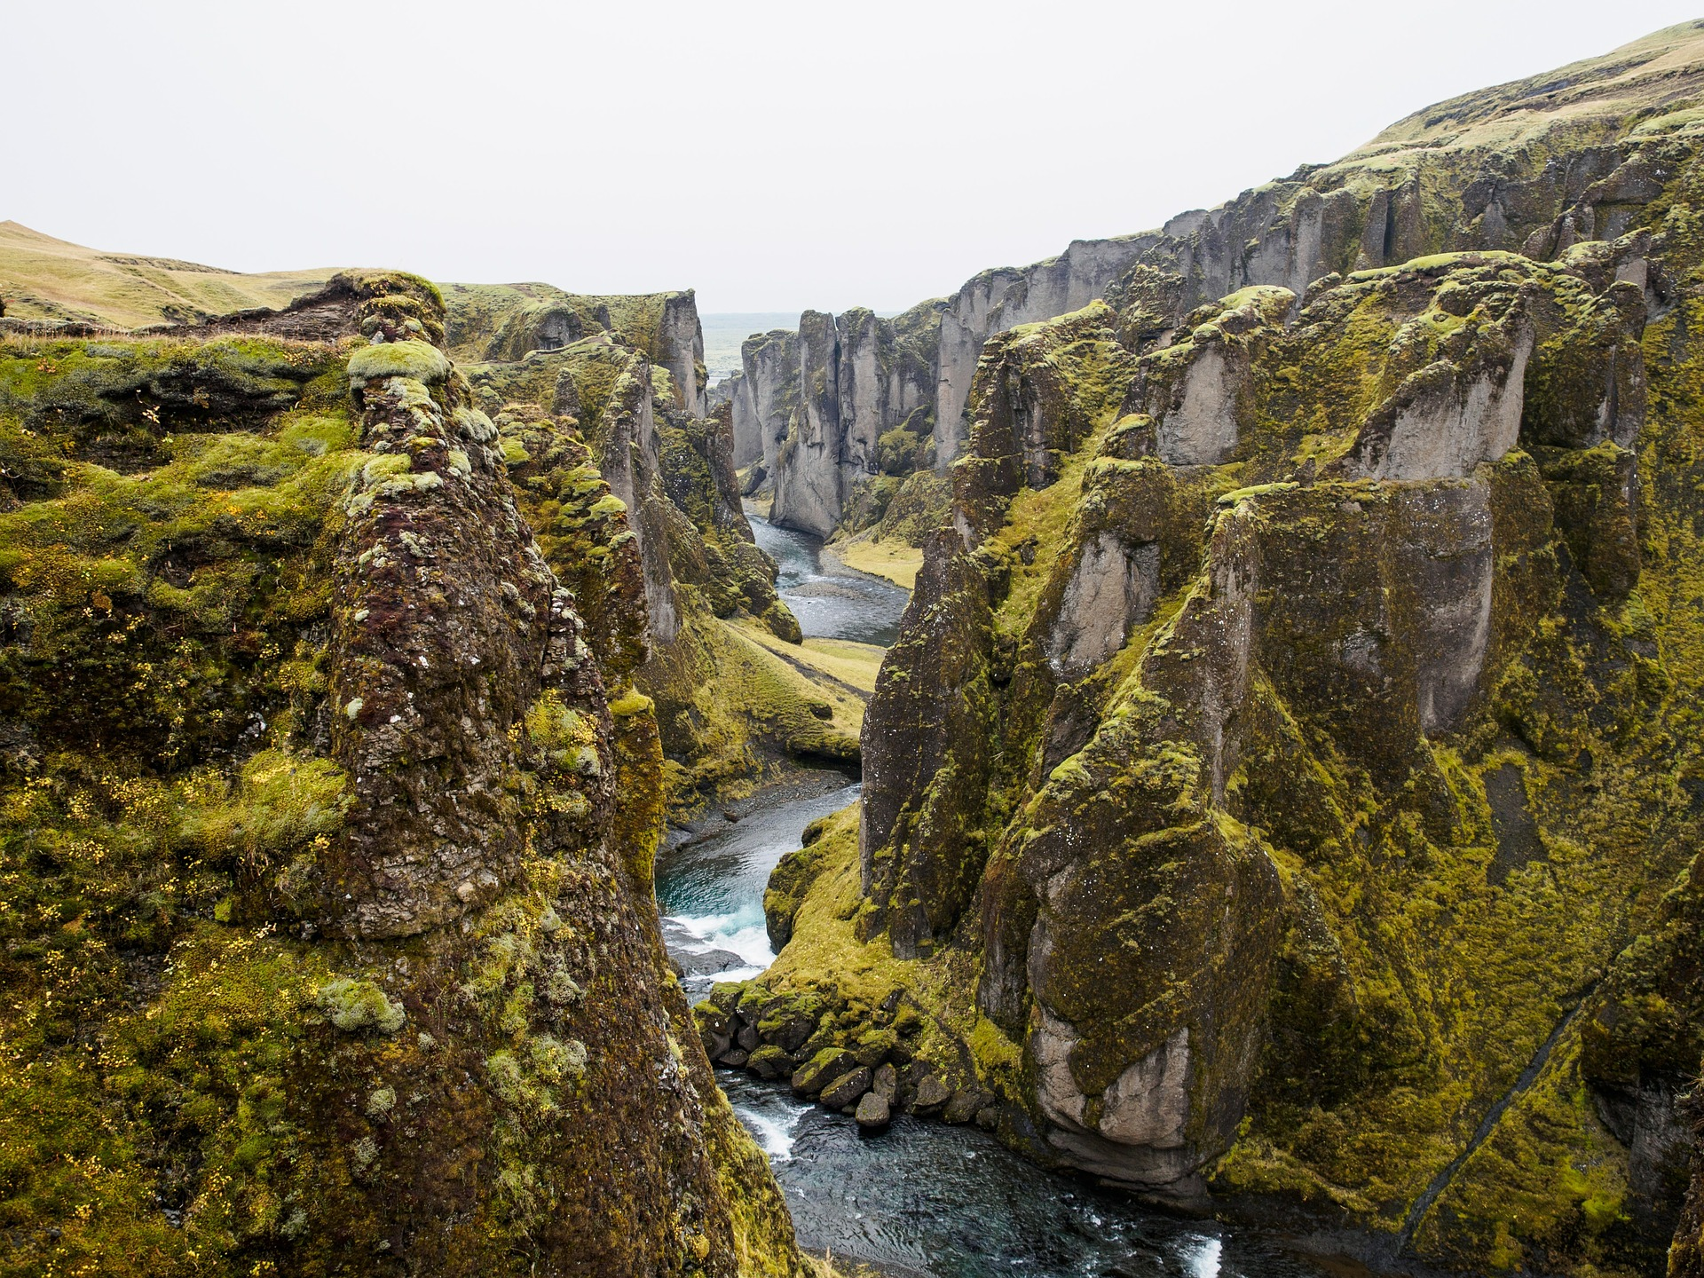

Slide 10
Glossary
Word | Definition
lava | Hot, molten rock which has come from a volcano or fissure.
molten | Melted and turned to liquid by intense heat.
volcano | A mountain or hill with a crater through which lava has erupted
magma | Hot fluid rock found beneath the Earth’s crust.

