Slide 1
Polar Swim
Lewis Pugh Swims Under the Antarctic Ice

Slide 2



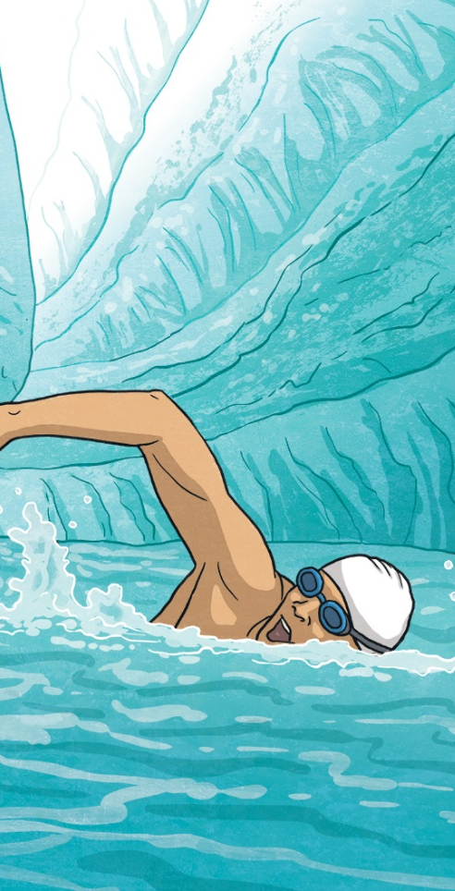

Daily News
Environment x World News x
29th January 2020
Lewis Pugh Swims Under the Antarctic Ice
Lewis Pugh has become the first person to swim under the ice in Antarctica!
Lewis Pugh is an endurance swimmer. In 2007, he became the first person to complete a long-distance swim across the North Pole. He’s also swam in every ocean in the world!
On 24th January, he swam in a river under an Antarctic glacier. The river was made from melting ice.
On social media, he said it was “the most beautiful and terrifying swim,” he’d ever done.
He had also planned to swim in a supra-glacial lake. This is a lake made by water melting on top of an ice sheet. Bad conditions meant he had to cancel it.
Lewis Pugh swam in Antarctica to raise awareness of climate change. This is the changing weather and rising temperature of the Earth.
Most scientists believe it is caused by human actions, such as burning fossil fuels for energy.
“We are facing a climate emergency,” Lewis said on social media.
Read the full article online here.
Where is Antarctica?
What are glaciers?
What is climate change?
How are people taking action on climate change?
Illustration: Lewis Pugh swimming under Antarctic ice
Click here to explore the 60-Second Read.
Notes:
Teacher Note - Please do not let the next video automatically play at the end of the clip. Please check the content in this link, including any comments, is suitable for your educational environment before showing. Twinkl accepts no responsibility for the content of third party websites.

Slide 3


Slide 4


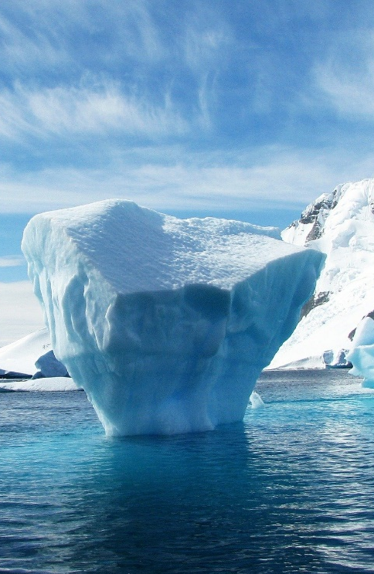


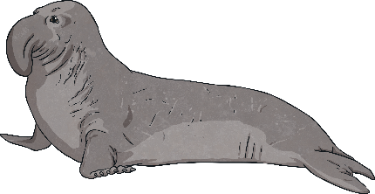
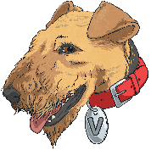
Where is the Antarctic?
variety
temperatures
explanation
The Antarctic is the polar region around the South Pole.
Scientists have become concerned that parts of the ice shelf are melting.
It includes the continent of Antarctica, the ice shelves and the islands in the South Ocean.
Some scientists believe that climate change might be the explanation for this.
Earlier this month, NASA released pictures showing what scientists called the “biggest melt event”.
Most of the area is permanently covered by snow and ice. A variety of animals living around the Antarctic have adapted to the cold temperatures.
Scientists are spending a lot of time examining ice shelves to find out what is happening. During summer, some even live on Antarctica!
Explore the photos of ice melt on NASA’s website.
Find a word which means forever.
Notes:
This page contains a link to an external website. Please be aware that the inclusion of any link in this resource should not be taken as an endorsement of any kind by Twinkl of the linked website or any association with its operators. Please check the content in this link, including any comments, is suitable for your educational environment before showing. Twinkl accepts no responsibility for the content of third-party websites.

Slide 5


Slide 6
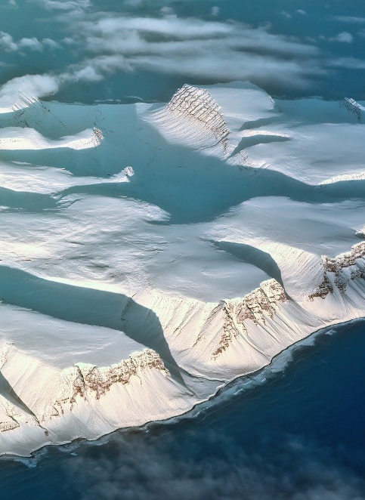

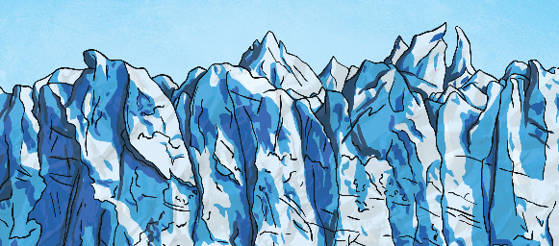

What Are Glaciers?
develop
environment
temperatures
Glaciers are large masses of ice. They usually form on mountains or in polar regions.
The movement is so slow, it’s often impossible to see.
When glaciers begin to melt, rivers of ice-cold water can appear on the surface, inside or even underneath!
They develop when new snow falls on old snow, turning it into heavy ice. As layers of ice build up, they form glaciers.
Lakes of melted water can also appear. These are called supra-glacial lakes.
They may look like they stay still but most are moving, just incredibly slowly!
Use an atlas or online map to find areas where you might expect to find glaciers.
Scientists are concerned that the changing environment and rising temperatures are impacting many glaciers.
How do you think climate change impacts glaciers?

Slide 7


Slide 8
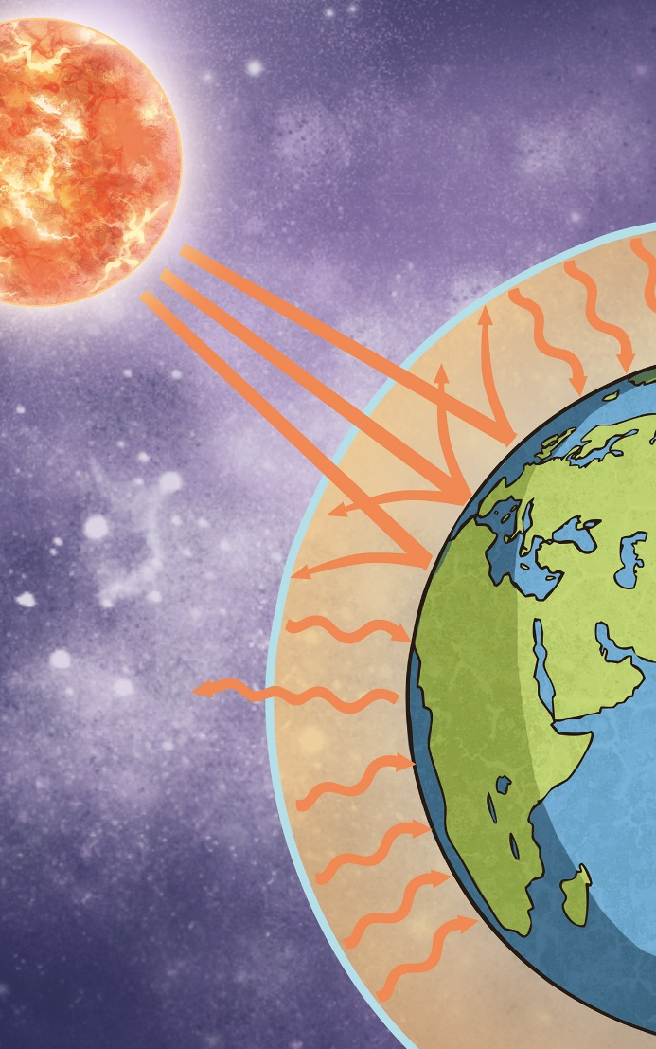
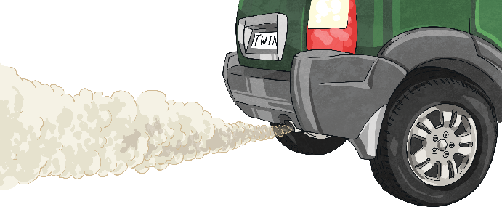

What Is Climate Change?
temperature
average
according
vehicles
Climate change is the changing temperature and weather of the Earth.
These gases are released by vehicles or by burning fossil fuels for electricity.
In the last 100 years, the average temperature has risen by about 1°C.
According to NASA, lots of studies have shown that most scientists believe it is caused by ‘human activities’.
Our atmosphere has a layer of gas, which keeps some heat in.
These harmful gases make this layer thicker. This traps more heat, warming up the Earth.
Investigate ways we can reduce our carbon footprint here.
Scientists believe that global warming is caused by gases, such as carbon dioxide or methane.
Find two things scientists believe is causing climate change.

Slide 9
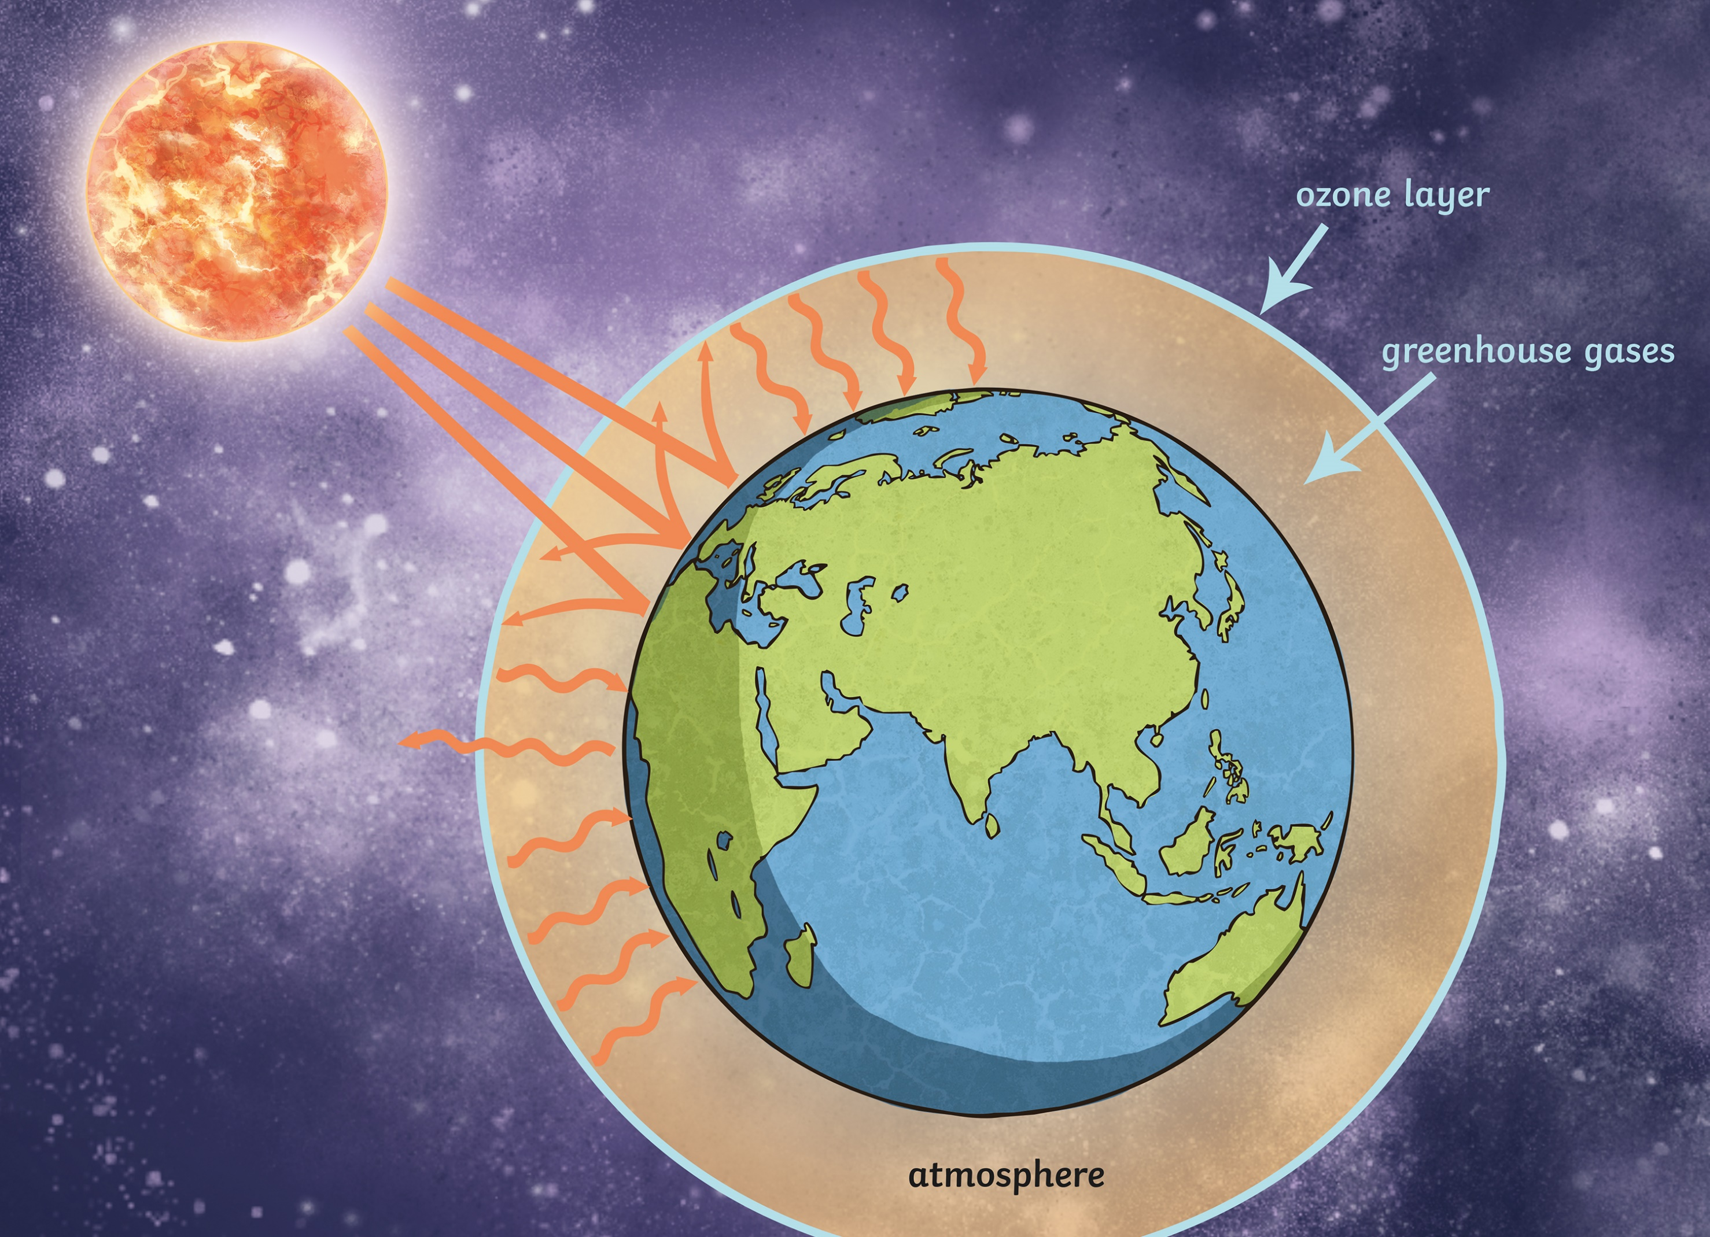

Slide 10
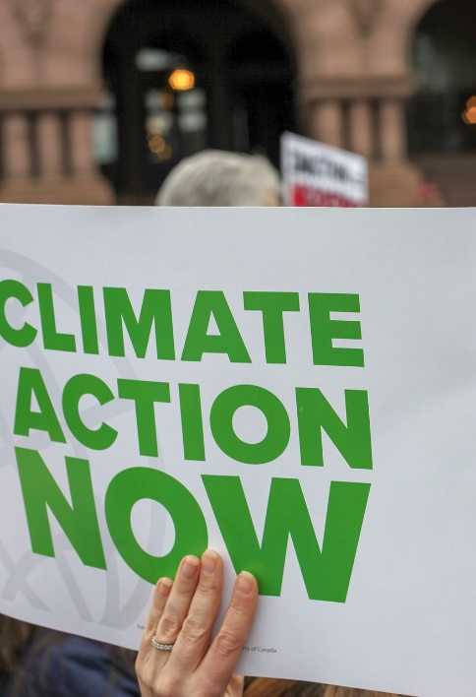
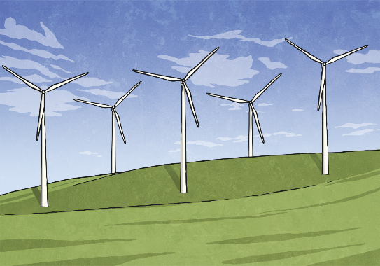

How are People Taking Action on Climate Change?
governments
parliament
conscious
Since 2019, young people have organised climate strikes. They have missed school to demand that governments do more to tackle climate change.
Governments are also acting. The UK government promised to reduce carbon emissions to zero by 2050.
They also want more power generated by cleaner energy, such as solar or wind power.
Greta Thunberg inspired these strikes when she began protesting outside the Swedish parliament. Climate strikes have occurred across the world.
Imagine and write a quote from a climate change protester.
Other young people, such as Finlay Pringle, have spoken about how climate change could affect animal species.
We can also act. We can be conscious of the electricity we use and try to use less.
Find a verb that means the same as ‘to be aware of’.

Slide 11


Slide 12
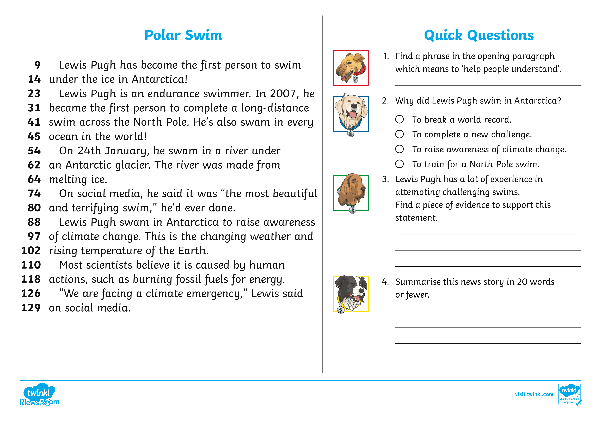

Slide 13
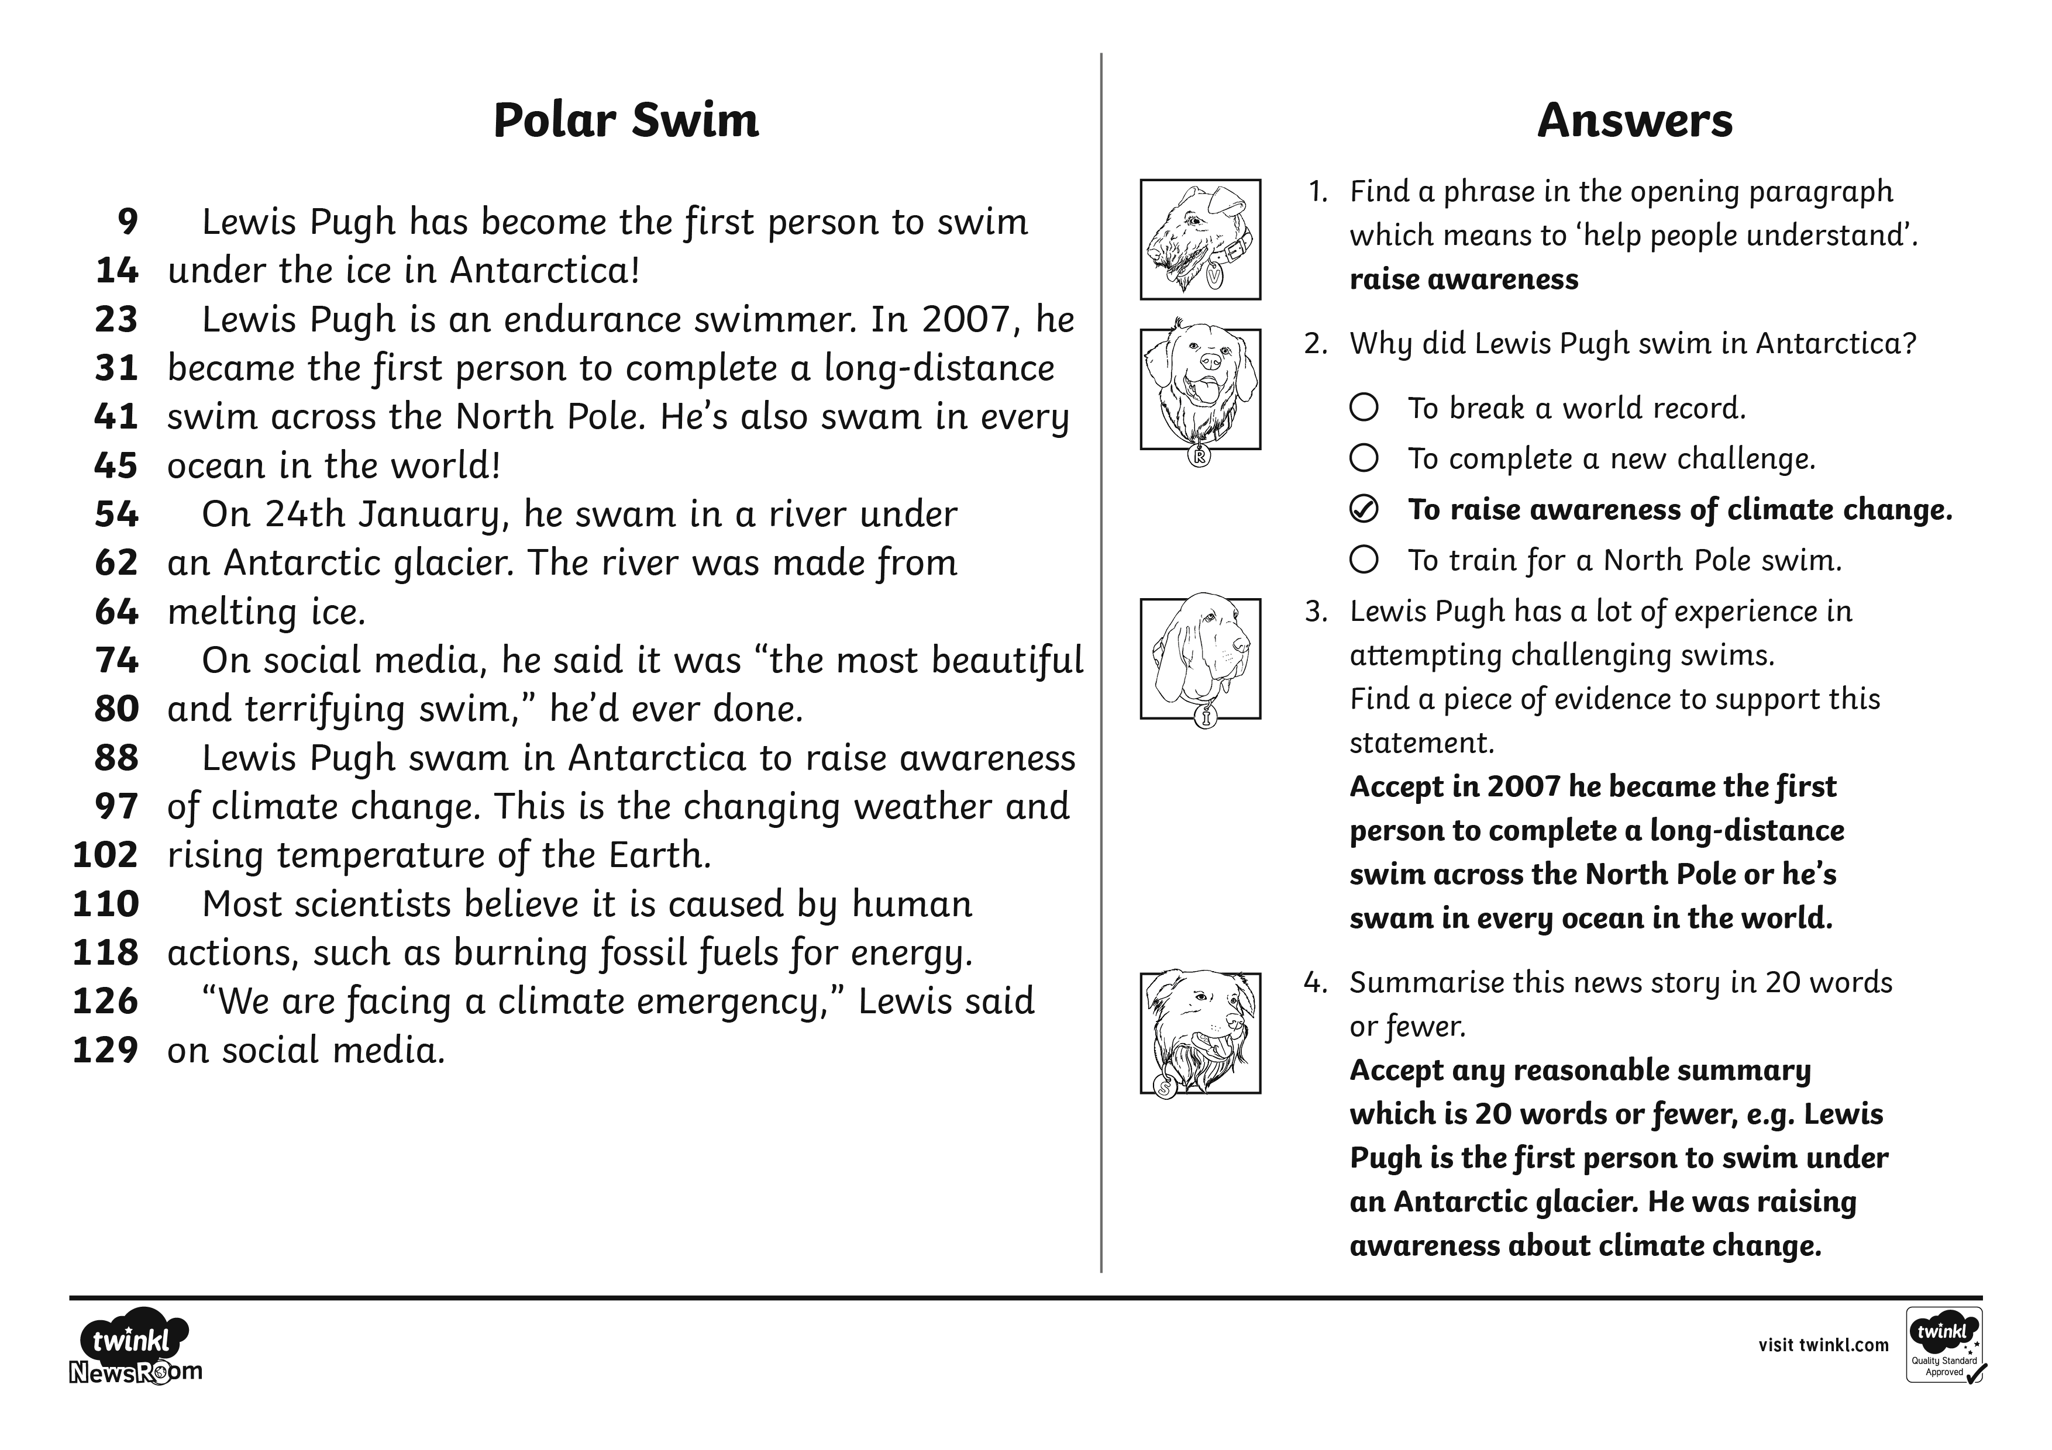

Slide 14
Glossary
Word | Definition
endurance | Describes a type of event or challenge which takes place over a long distance and needs a lot of physical effort.
glacier | A huge body of ice often found on mountains or in polar regions.
conditions | The weather, climate or other things which affect the situation of an area.
fossil fuels | A natural fuel found in the ground, such as coal or gas.

