Slide 2
Escape the Cave
It’s the weekend and your family are enjoying a picnic in the woods. After everyone has finished eating, you and your big sister ask if you can go and explore. “Okay,” Dad says, “but stay together. Take my phone so you can call Mum in an emergency.” You take the phone and set off.
After a while, you come across the entrance to a dark, gloomy cave. “Come on,” exclaims your sister. “Let’s investigate!” You both have fun exploring the cave. All of a sudden, you hear a scream. You turn around to see your sister on the floor, clutching her foot in pain. “Quick, call Mum’s phone!” she yells.
You take the phone and try to dial but it is locked. In your panic, you can’t remember the security code!
Solve the clues and puzzles to discover the phone security code and escape the cave. The clues could be anywhere so you need to keep your eyes peeled and your mind sharp!

Slide 3
Escape the Cave
The Rules
You can work in small groups.
When you find a clue, work together to solve the puzzle.
Write your answer down on your answer sheet.
Once you have discovered the phone security code, check it with your teacher to discover if you can call for help and escape the cave!

Slide 4
Escape the Cave
Answers to the Clues

Slide 5
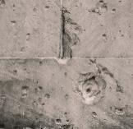
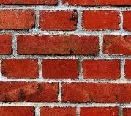
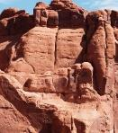
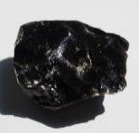
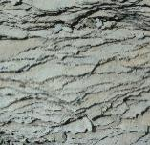
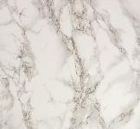
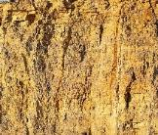
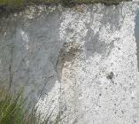
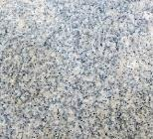
Escape the Cave – Clue 1
Sort these rocks into natural and man-made.
Man-made
Natural
limestone
marble
chalk
sandstone
obsidian
slate
concrete
brick
concrete
sandstone
obsidian
granite
brick
marble
limestone
granite
chalk
slate
Concrete and brick are man-made rocks.
The first digit of the security code is two.
2

Slide 6
Escape the Cave – Clue 2
How many of these are real types of natural rock?
noxious | caption | metamorphic
igneous | verdant | adhesive
brawny | sedimentary | corrod
Metamorphic, igneous and sedimentary are natural types of rock.
The second digit of the security code is three.
3

Slide 7
Escape the Cave – Clue 3
Read the clues and write the answer with one letter in each box. The letters in the green boxes spell the next number.
Type of natural rock formed from magma or lava.
i | g | n | e | o | u | s
Type of natural rock formed under the sea.
s | e | d | i | m | e | n | t | a | r | y
Natural rocks that change due to being near lava.
m | e | t | a | m | o | r | p | h | i | c
The letters spell out the word ‘one’.
The third digit of the security code is one.
1

Slide 8
Escape the Cave – Clue 4
These are the steps of how a fossil is formed but they are in the wrong order.
Over thousands of years, sediment forms over the bones and forms a hard rock.
More layers of rock cover the dead animal until only its bones are left.
Eventually, the fossil can be seen.
In some places, the sea recedes (goes back).
An animal dies and ends up in the sea covered by a layer of sediment.
Correct order
An animal dies and ends up in the sea covered by a layer of sediment.
Over thousands of years, sediment forms over the bones and forms a hard rock.
More layers of rock cover the dead animal until only its bones are left.
In some places, the sea recedes (goes back).
Eventually, the fossil can be seen.
The stage when the sea recedes is the fourth stage.
The fourth digit of the security code is four.
4

Slide 9
Escape the Cave – Clue 5
Soil is made from how many of these things?
air | plastic | water
metal | organic matter | glass
minerals | nylon | leather
Soil is made from air, water, organic matter and minerals.
The fifth digit of the security code is four.
4

Slide 10
Escape the Cave – Clue 6
Read these sentences about properties of rocks. Some are true statements and some are false.
 | True | False
Permeable rocks allow water to pass through them.
Durable rocks can be broken down easily by weathering.
Density measures how bulky rocks are. High-density rocks sink; low-density rocks float.
You can test the hardness of rocks by seeing if they will scratch glass.
The sixth digit of the security code is one.
1

Slide 11
Escape the Cave – Clue 7
Class 3 did an experiment to test the permeability of different soils. They put their results in a bar chart.
10
9
8
7
6
Amount of Water That Passed
through the Soil (cm)
5
4
3
2
1
0
Soil A Soil B Soil C Soil D Soil E
Soil Sample
Soil B was the most permeable and let 9cm of water through. Soil A was the least permeable and let 1cm of water through. 9 – 1 = 8
The seventh digit of the security code is eight.
8

Slide 12
Escape the Cave – Clue 8
Read the clues about layers of soils.
This layer is made of a solid layer of rock.
The middle layer of soil.
The thinnest layer where most plants and animals live.
rock
bed
soil
sub
soil
top
3 + 3 + 3 = 9
The eighth digit of the security code is nine.
9

Slide 13
Escape the Cave
Now you’ve solved all the clues, it’s time to enter the code into the phone and escape the cave!
Digit
1
Digit
2
Digit
3
Digit
4
Digit
5
Digit
6
Digit
7
Digit
8
2
3
1
4
4
1
8
9

