Slide 1

The Mayans
LO: to explore where and when the remains of the Mayan civilisation were discovered.
NEXT
www.planbee.com

Slide 2
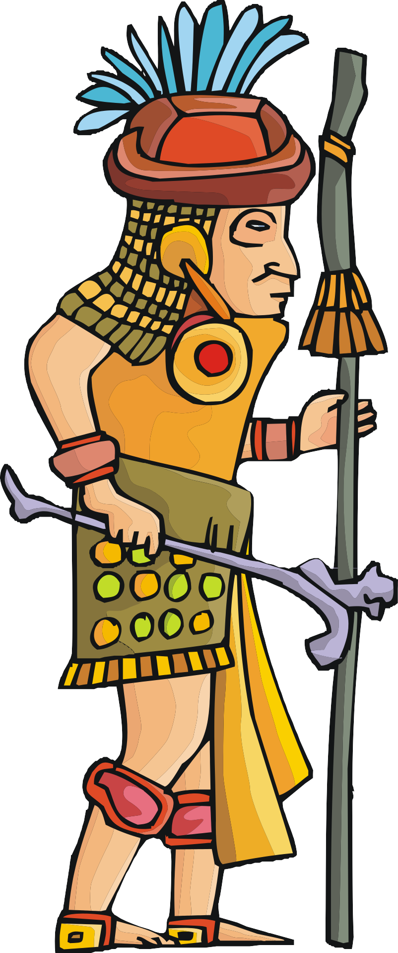

What do you already know about the
Mayans?
BACK
NEXT
www.planbee.com

Slide 3
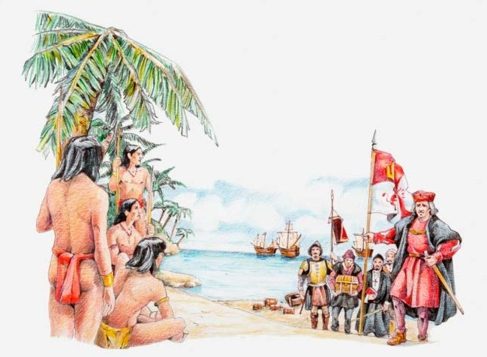

Europeans first discovered the Americas in 1492 when Christopher Columbus first sailed from Europe to America. He returned with tales of a rich and vast land filled with gold and other precious materials.
After that, many other Europeans sailed to America in search of gold and glory.
They met lots of native people.
The Europeans thought they were savages and battled to take over their lands.
BACK
NEXT
www.planbee.com

Slide 4
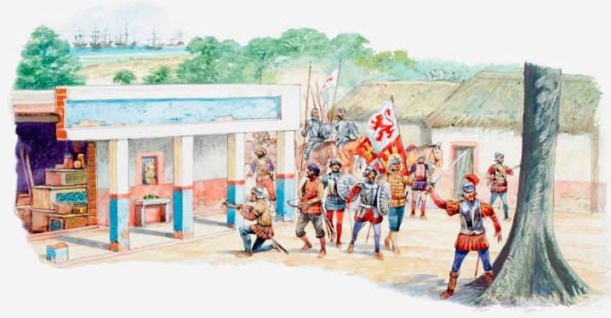
In 1519, a group of Spanish explorers, led by a man called Hernan Cortès, sailed to Mexico. There they met a people called the Aztecs. The Spanish explorers (who came to be known as conquistadors) fought to take over the Aztec lands and after two years they succeeded. The Aztecs were defeated and Mexico became a Spanish colony.
BACK
NEXT
www.planbee.com

Slide 5
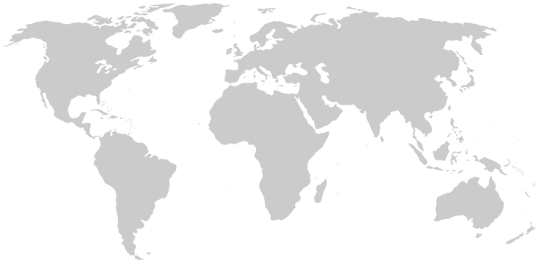
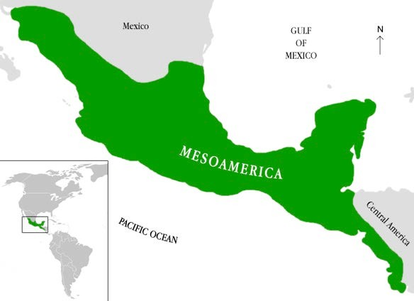
Once the conquistadors had conquered the Aztecs, they went on to explore the rest of Mesoamerica. Mesoamerica is the land in between North and South America.
North America
Europe
Asia
Africa
South America
BACK
NEXT
www.planbee.com

Slide 6
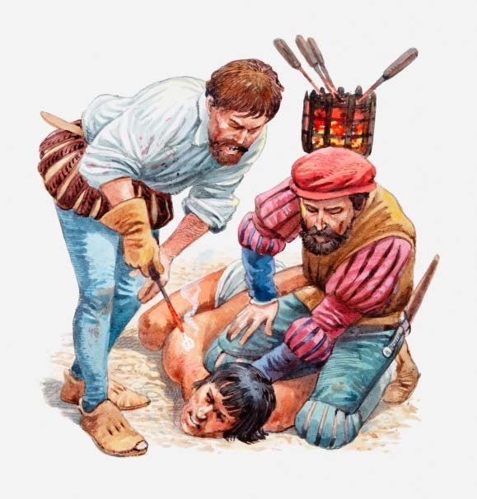
The conquistadors travelled through Mesoamerica. Some of the land was mountainous and rugged. Some was dense and humid rainforest. On their way, they came across many native people that they had to defeat before moving on.
The conquistadors thought the native people were savages who were not as advanced or as civilised as the Europeans. The Spanish believed they had more right to the land than the natives who had lived there for thousands of years.
BACK
NEXT
www.planbee.com

Slide 7

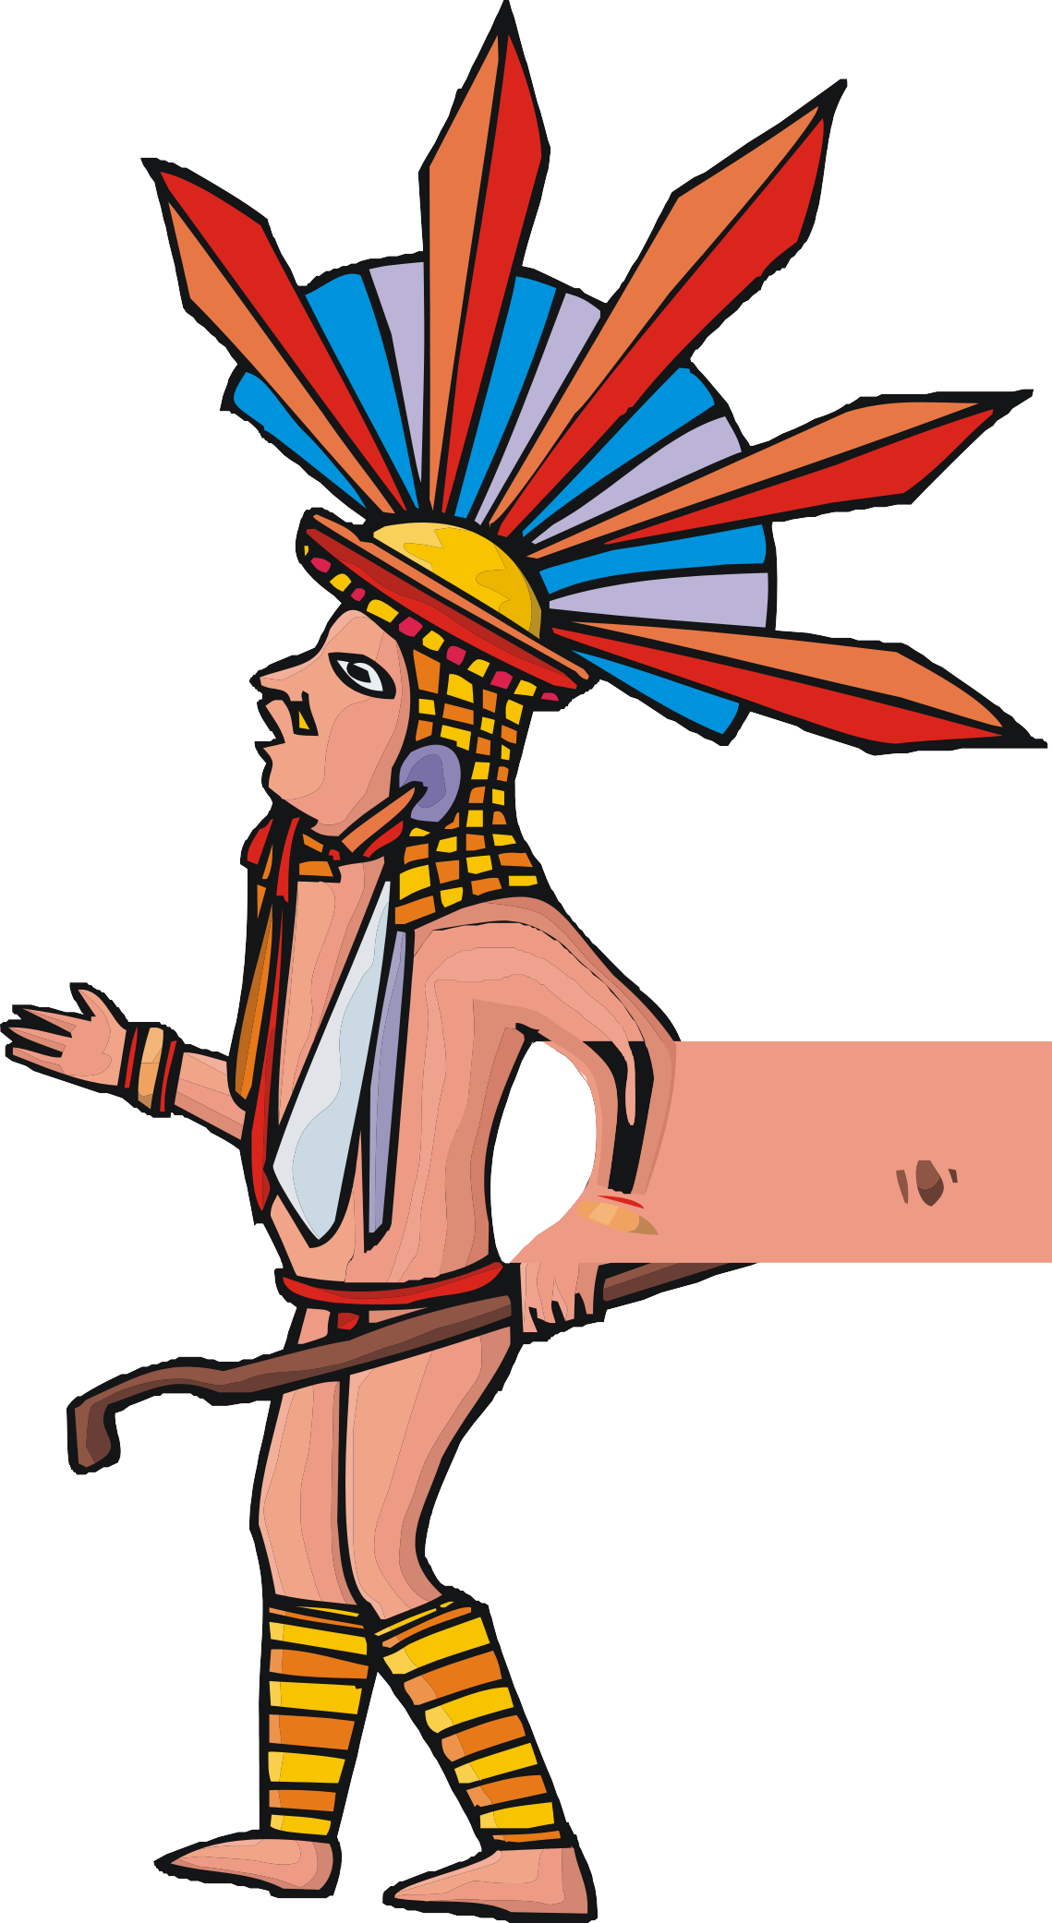
Then one day, deep in the wild rainforest, the conquistadors came across something that amazed them.
What do you think they found?
Let’s have a look...
BACK
NEXT
www.planbee.com

Slide 8
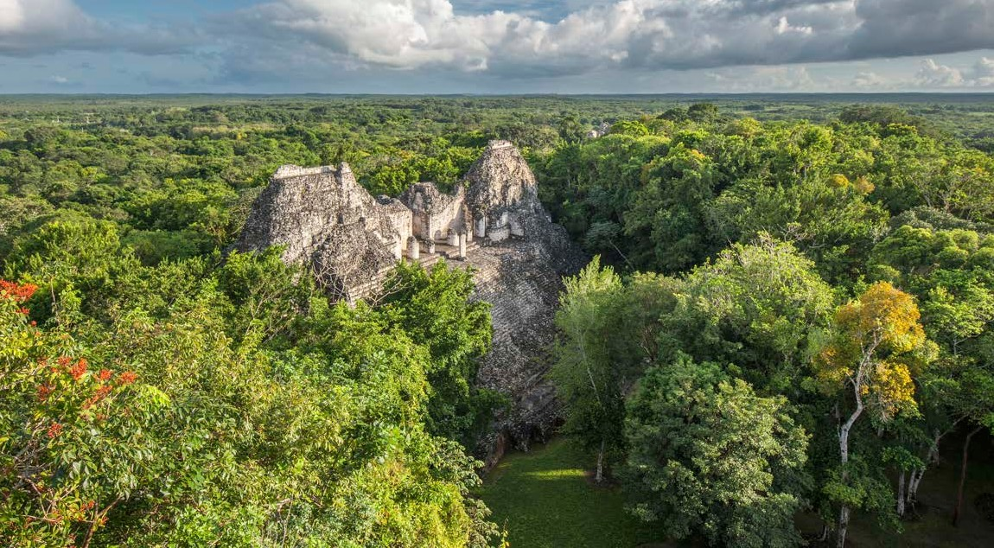
Describe what you can see?
What do you think it is? Why do you think that?
BACK
NEXT
www.planbee.com

Slide 9
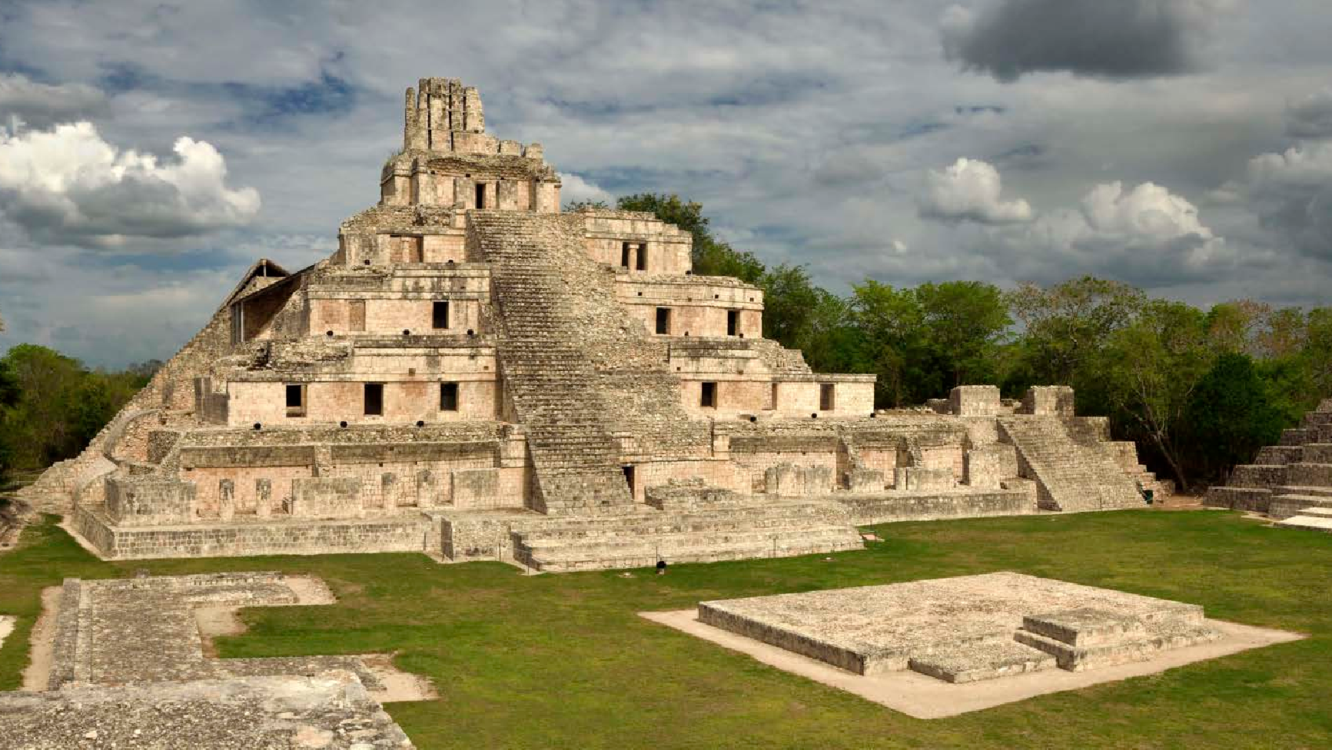
What do you think it is? Why?
How do you think the Conquistadors reacted when they saw this for the first time?
BACK
NEXT
www.planbee.com

Slide 10
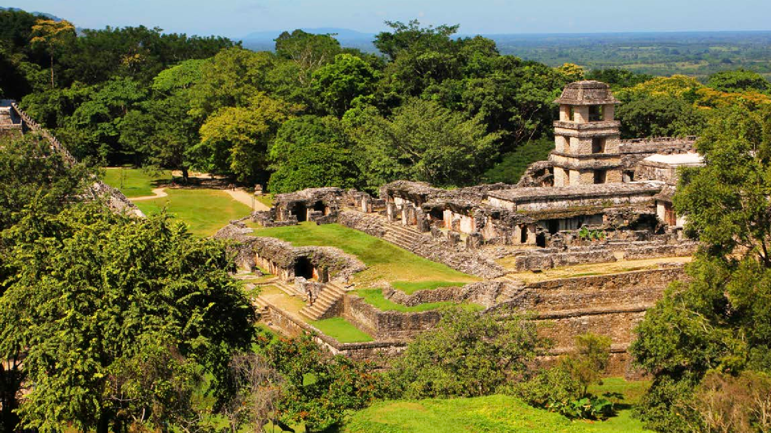
Describe what you can see?
What would you think if you saw this in real life for the first time?
BACK
NEXT
www.planbee.com

Slide 11
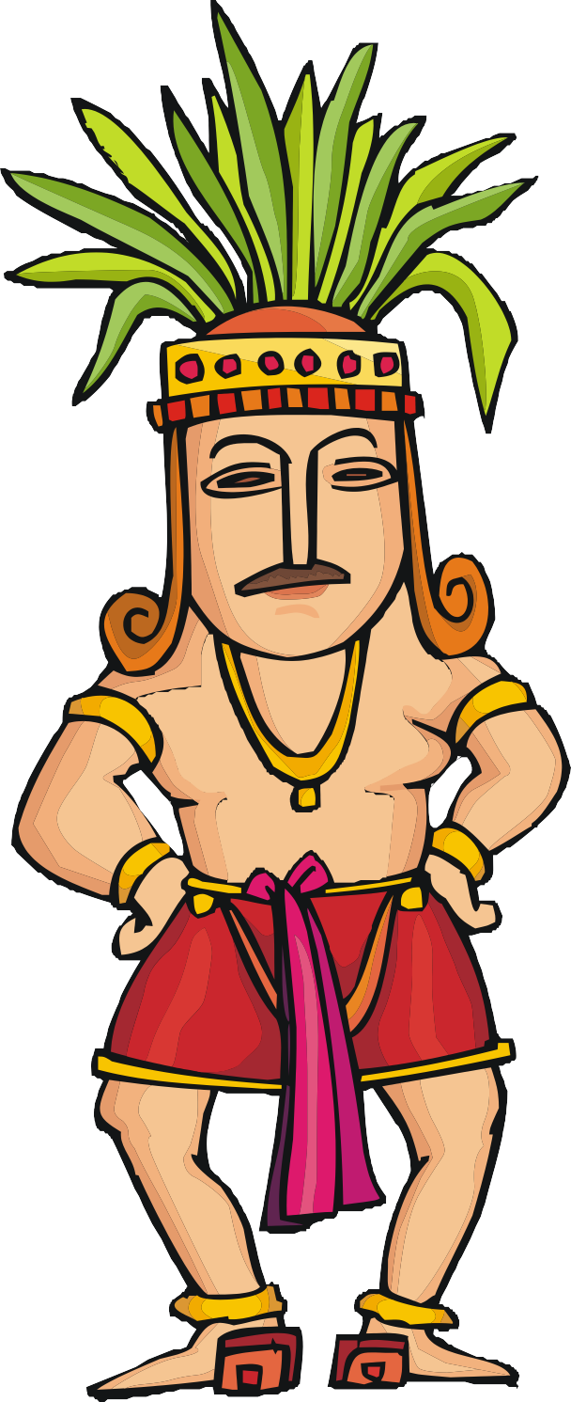
The Spanish conquistadors discovered whole abandoned cities with strange pyramids and other buildings in the middle of the rainforest.
How do you think the conquistadors might have felt when they discovered these cities?
What questions do you think they might have asked about what they found?
BACK
NEXT
www.planbee.com

Slide 12
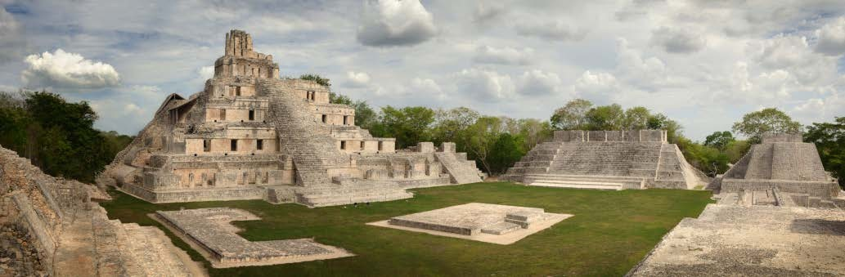
It wasn’t until about 150 years later that more Europeans and North Americans explored these ruins further. They found many more sites and started to understand more about the people who had lived there.
BACK
www.planbee.com

Slide 13
In which countries can you find many of the Ancient Maya sites?
The text refers to ‘intriguing remain’. What does the word intriguing mean in this context?
Which is the most popular and well-known of the Ancient Maya sites?
How do the pictures help the reader?
From reading the section ‘Chichen Itza’, give three reasons why you think it has so many visitors?
Why do you think the title refers to the ‘Lost Cities of Ancient Maya?’
Summarise the main ideas in the first section ‘Visit the Ancient Maya’.
Make a list of the reasons why a visitor may choose Tikal as a place to visit.
The Palenque jungle ruins are described as ‘breath-taking’. Why does the writer use this word and how it being described?
Which of the four sites mentioned would you like to visit and why? Draw a picture of your favourite site.

