Slide 2
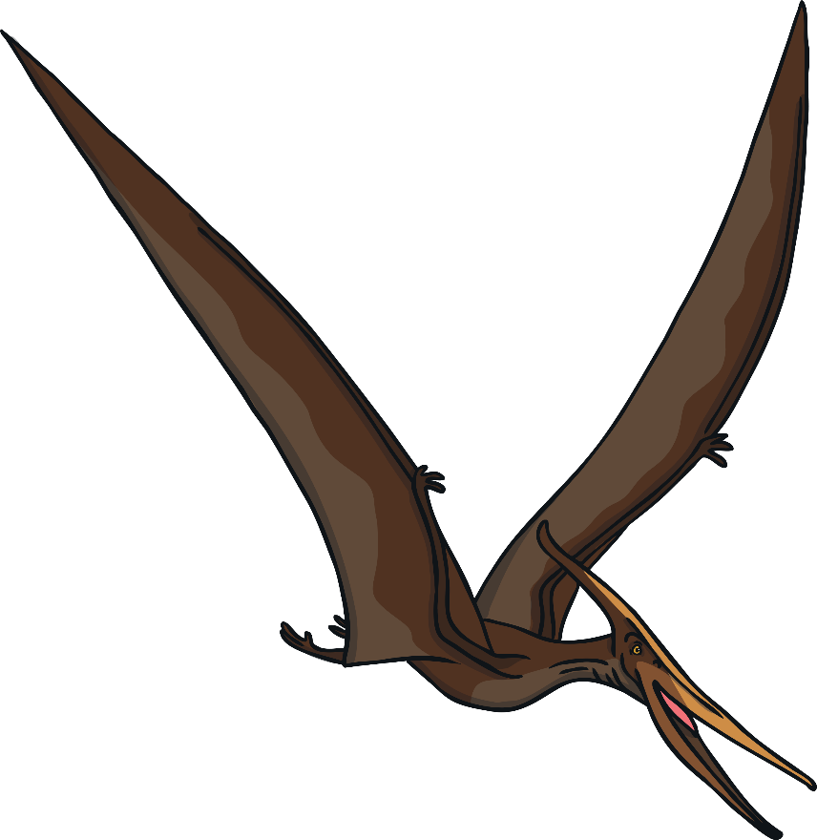
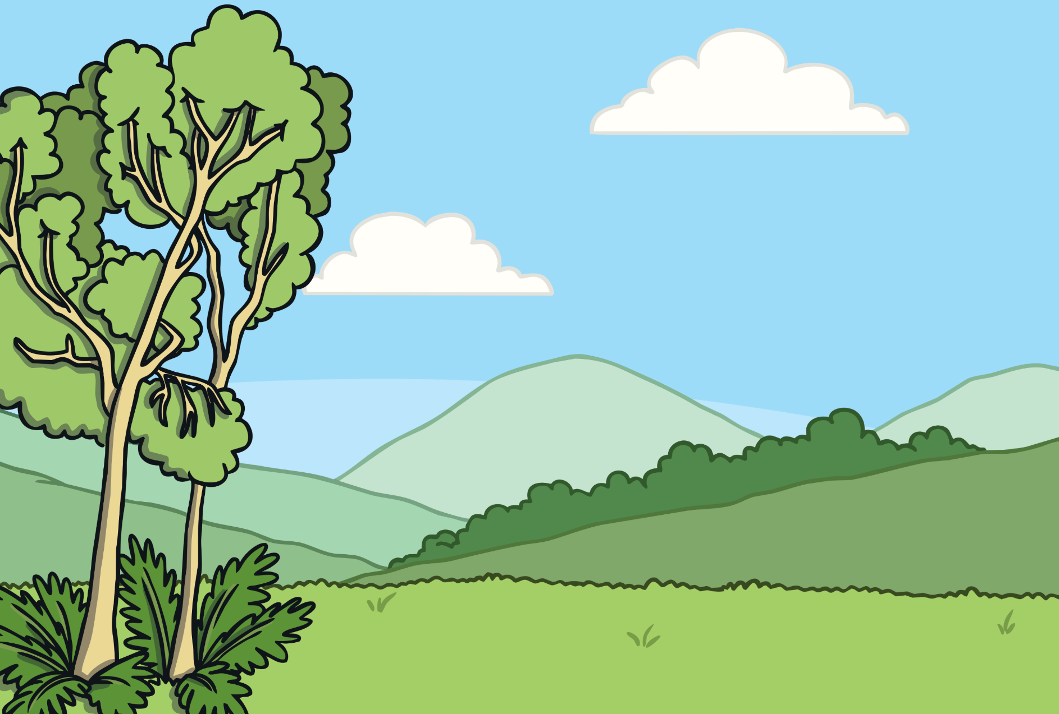

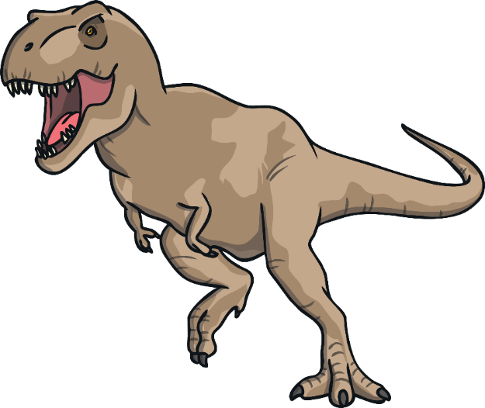
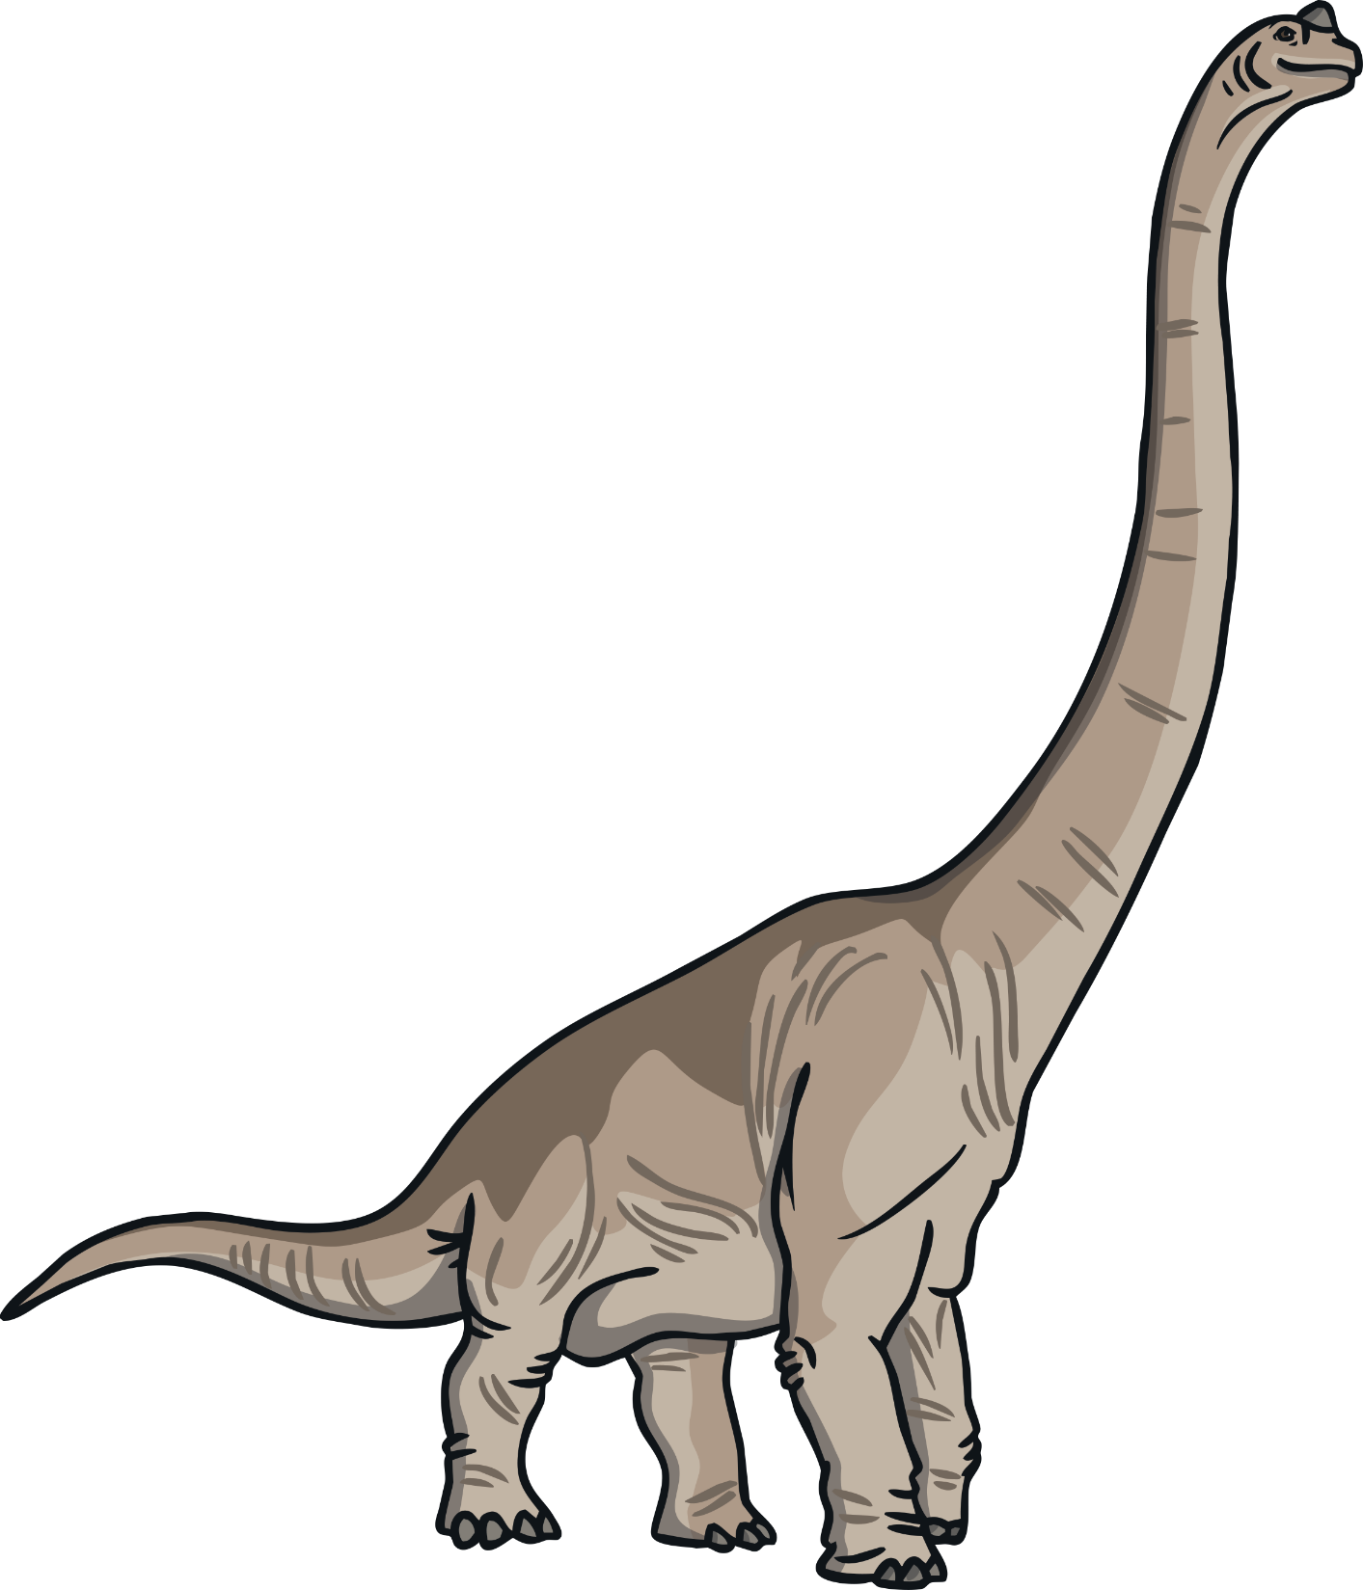
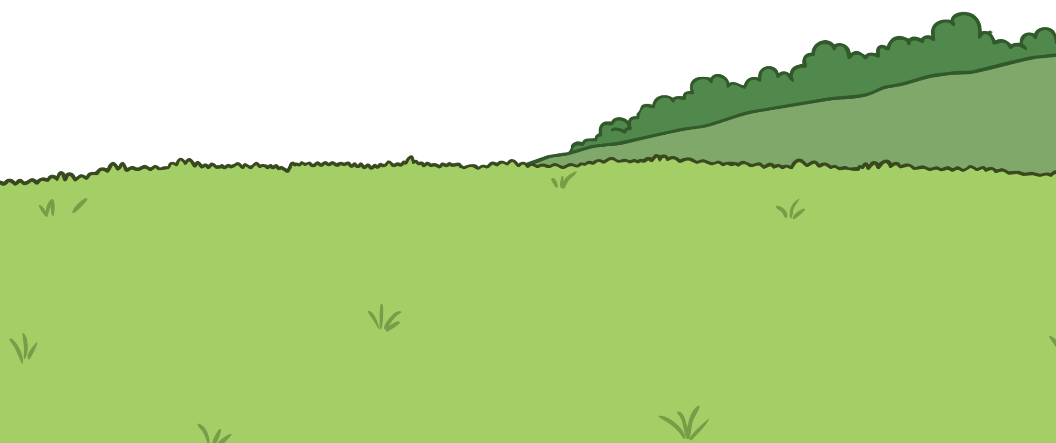
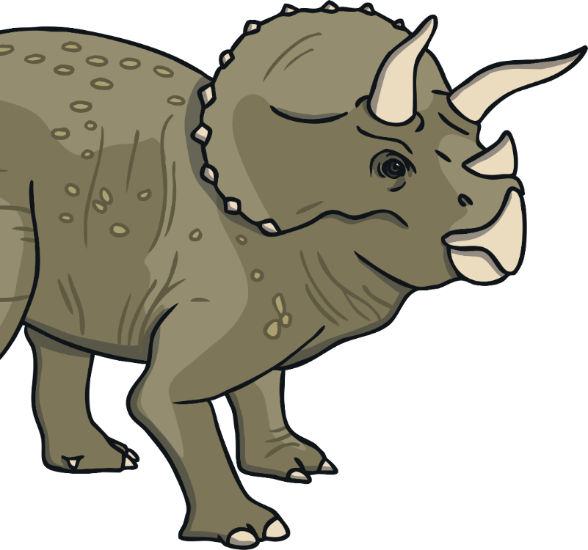
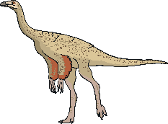
Dinosaurs lived millions of years ago, before people

Slide 3
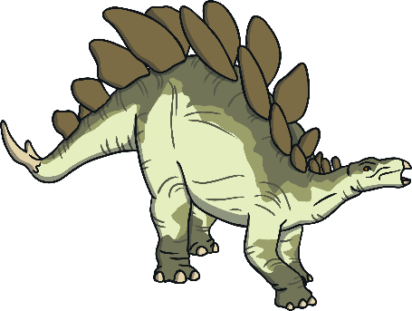

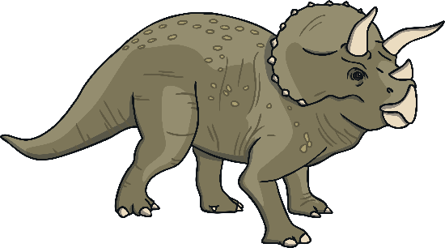
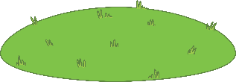
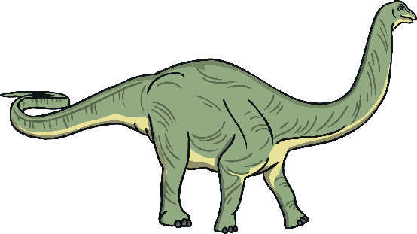
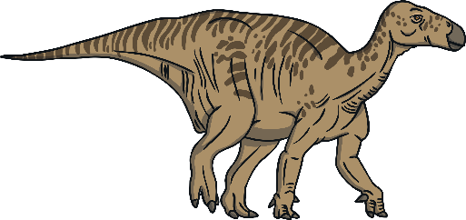

Most dinosaurs were herbivores or plant eaters.
Triceratops
Stegasaurus
Apatosaurus
Iguanodon
Brachiosaurus

Slide 4

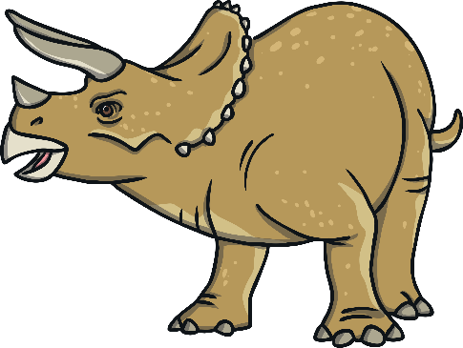

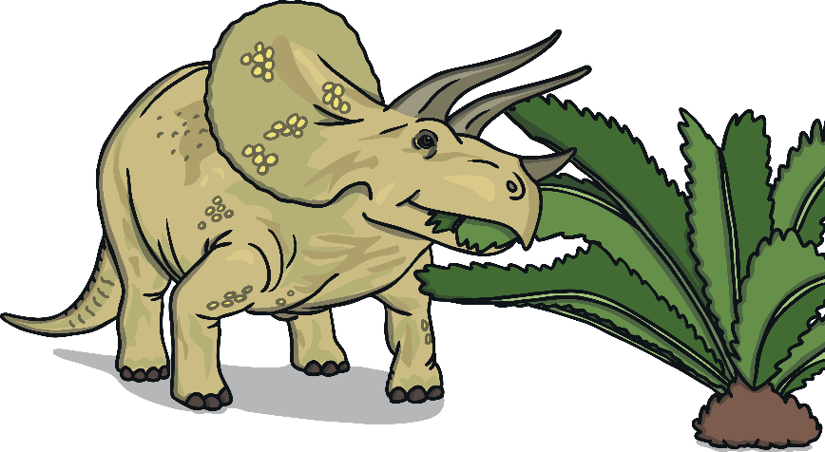
Living on the Plains
Many dinosaurs lived on the plains. They were covered in ferns and other plants. The herbivores lived here in large groups called herds.
A herd of Triceratops

Slide 5
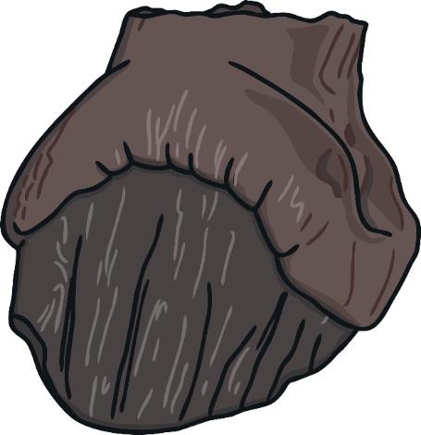

Herbivores’ teeth were often blunt and flat to help them crush and grind down plants.

Slide 6

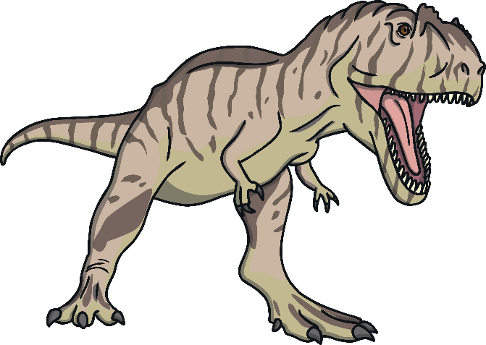

The big carnivores, or meat eaters, also lived on the plains as there were plenty of other dinosaurs to eat.
Tyrannosaurus Rex
Giganotosaurus

Slide 7

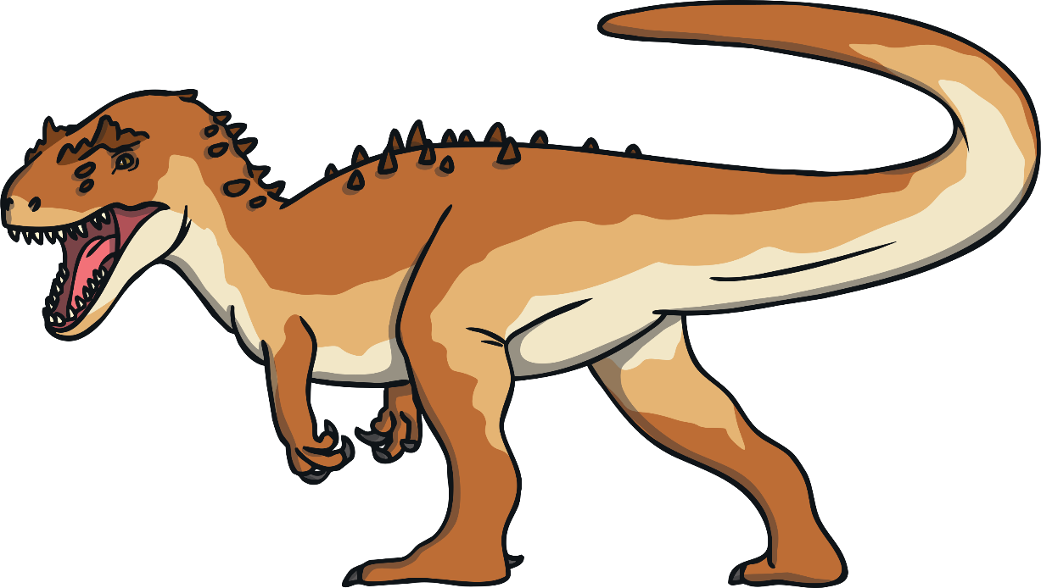
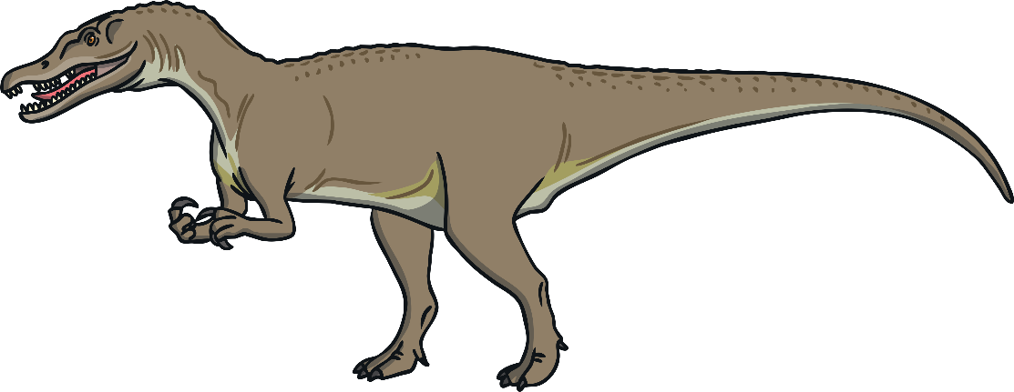
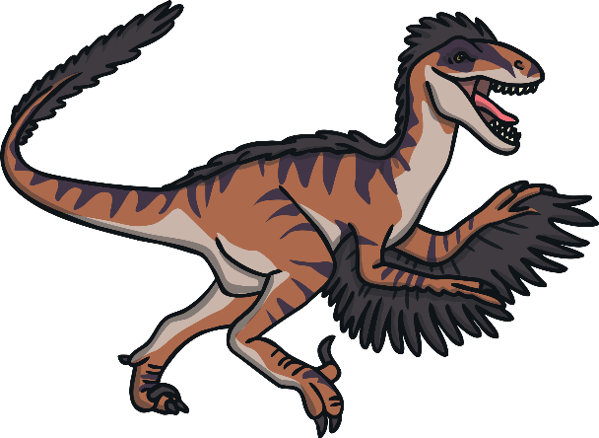
Carnivores had teeth that were sharp like knives so that they could cut through meat.

Slide 8
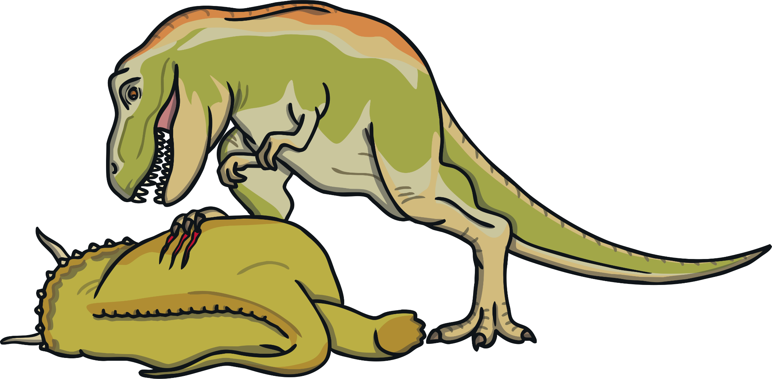
Carnivores on the plains had strong, long legs so that they could move quickly to catch their prey.
Herbivores were slower as their food gave them less energy.

Slide 9
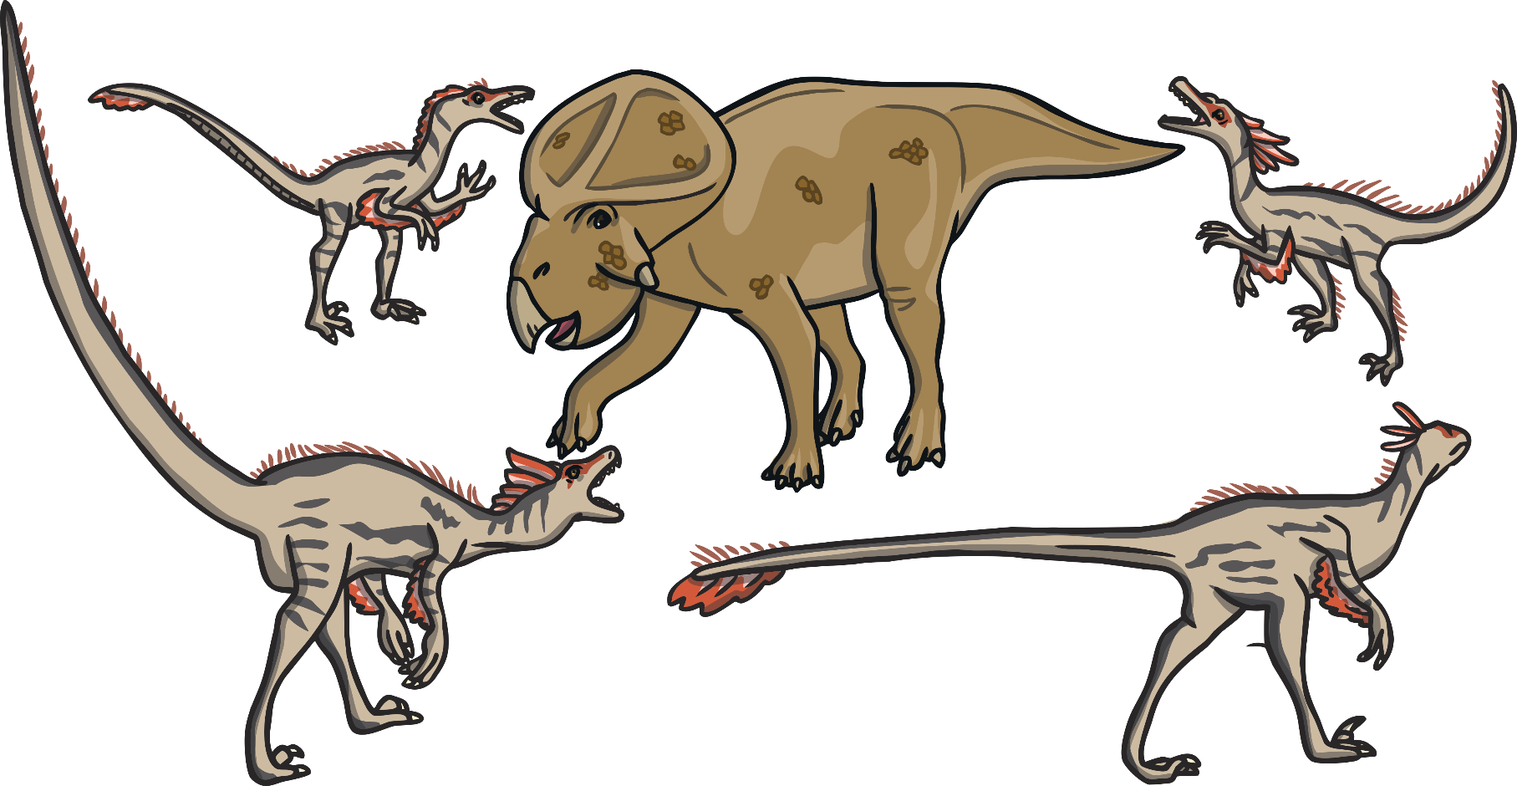
Smaller meat eaters, like these clever velociraptors, hunted in packs. Sometimes they would eat the meat that other larger carnivores had left behind.

Slide 10
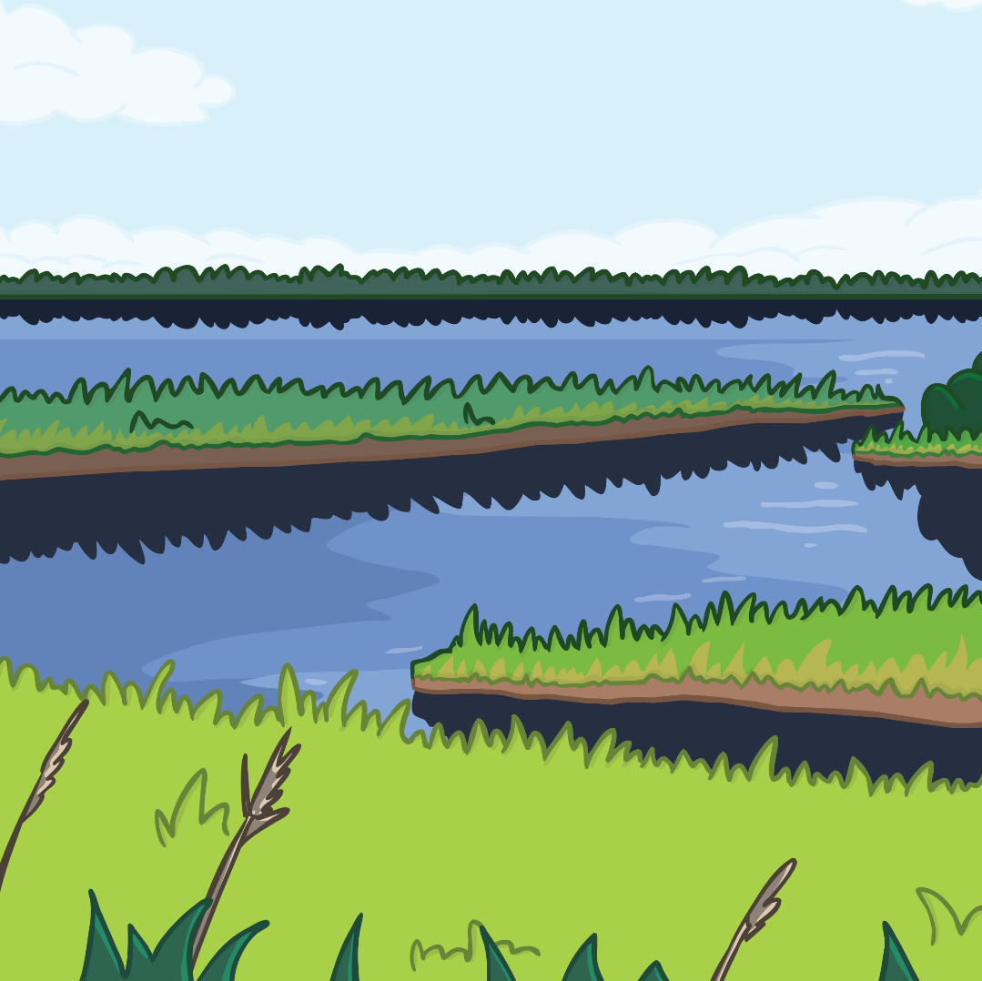

Living on the Wetlands
Wetlands were soggy plains. The Iguanodon, and other herbivores liked to live here. They ate a plant that grew here called horsetails.

Slide 11
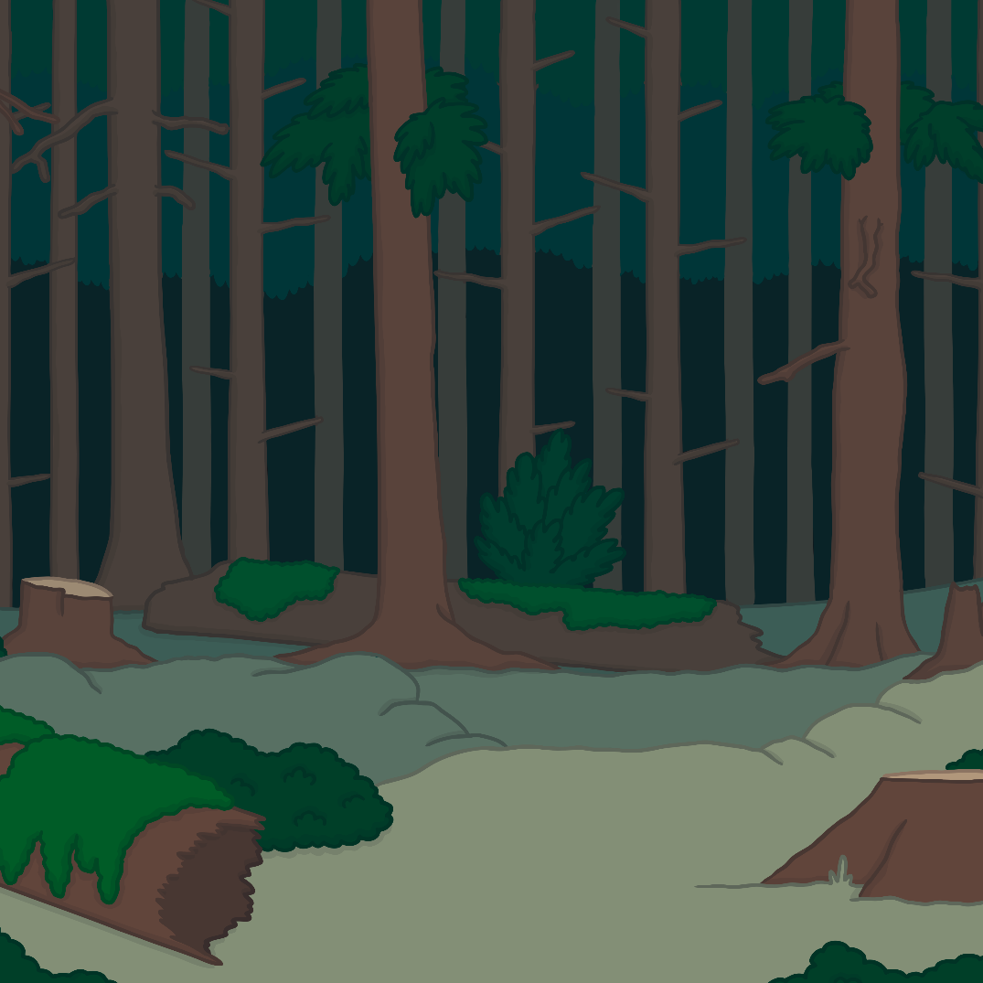
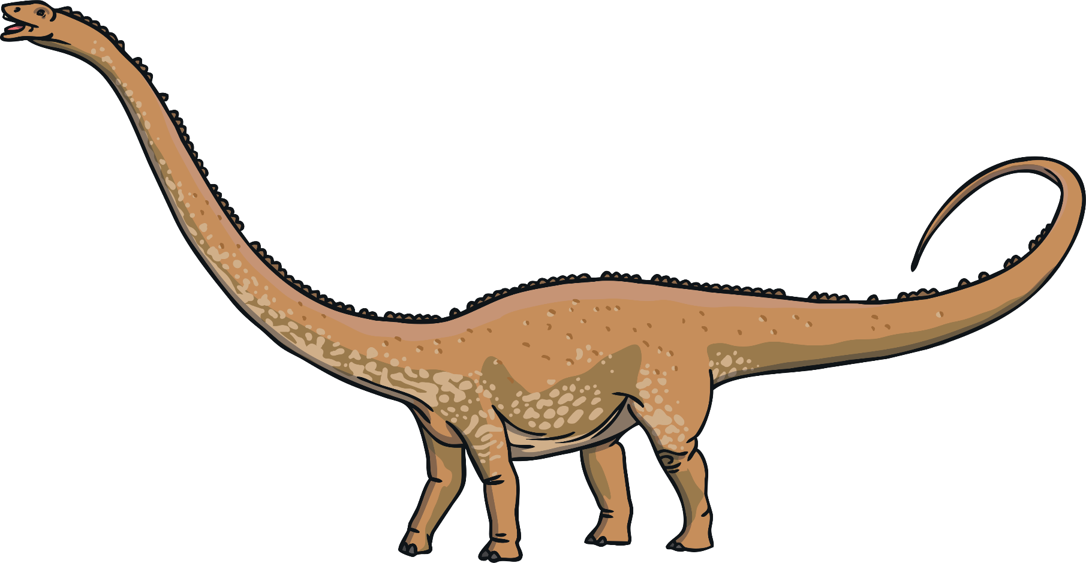
Living in the Forest
Dinosaurs like Diplodocus, lived in the forest areas. Diplodocus mostly ate leaves. They didn’t have any teeth in the back of their mouth for chewing. Scientists think that they swallowed stones to help grind up their food.

Slide 12

Living in the Forest
Apatosaurus also lived in the forest and had long, thin teeth to help them rake through leaves.

Slide 13
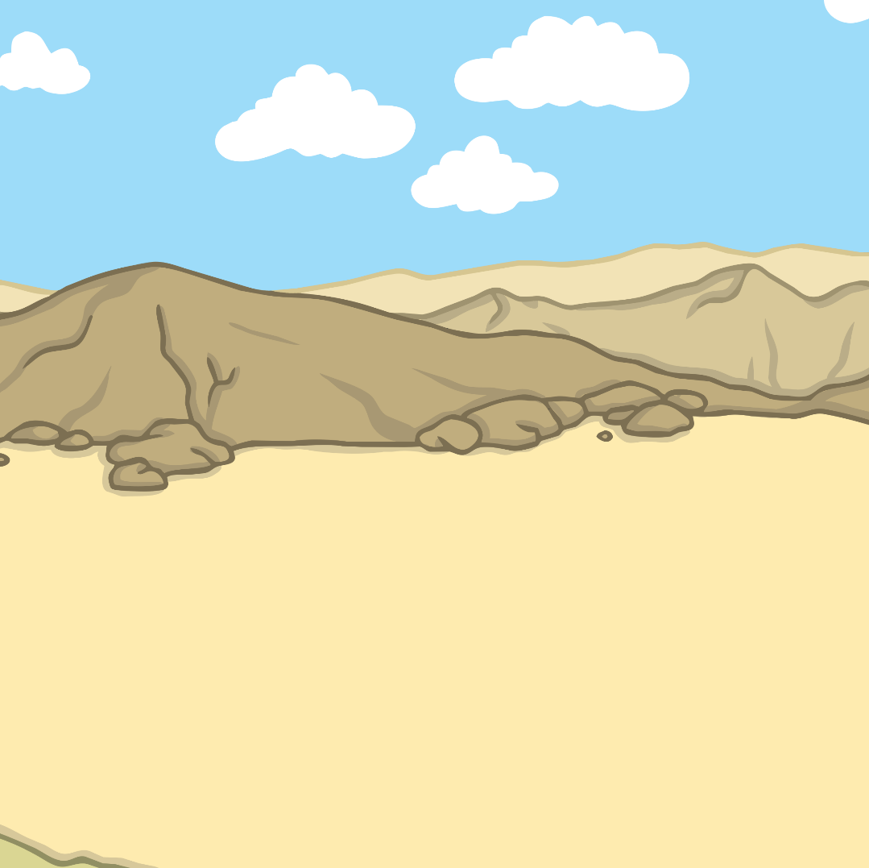
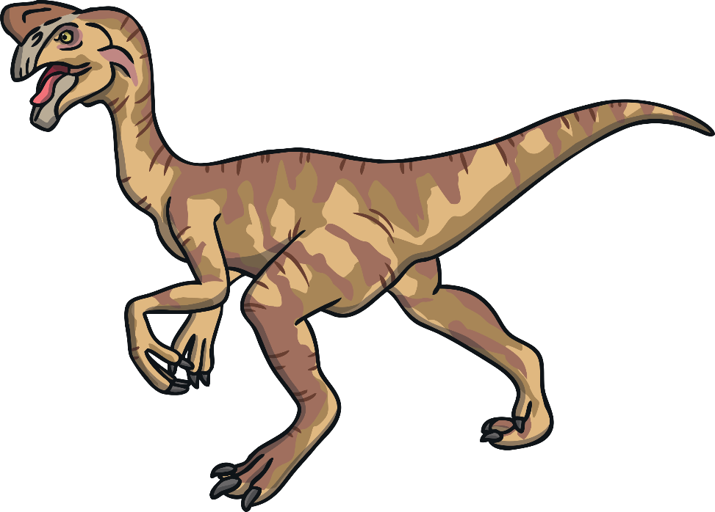
Living in the Desert
Deserts are very dry and hot but some dinosaurs still lived here. Oviraptor managed to survive because they were omnivores.
How do you think being an omnivore helped them survive?
Omnivores often had a beak and no teeth for
cracking eggs and picking up plants.

Slide 14
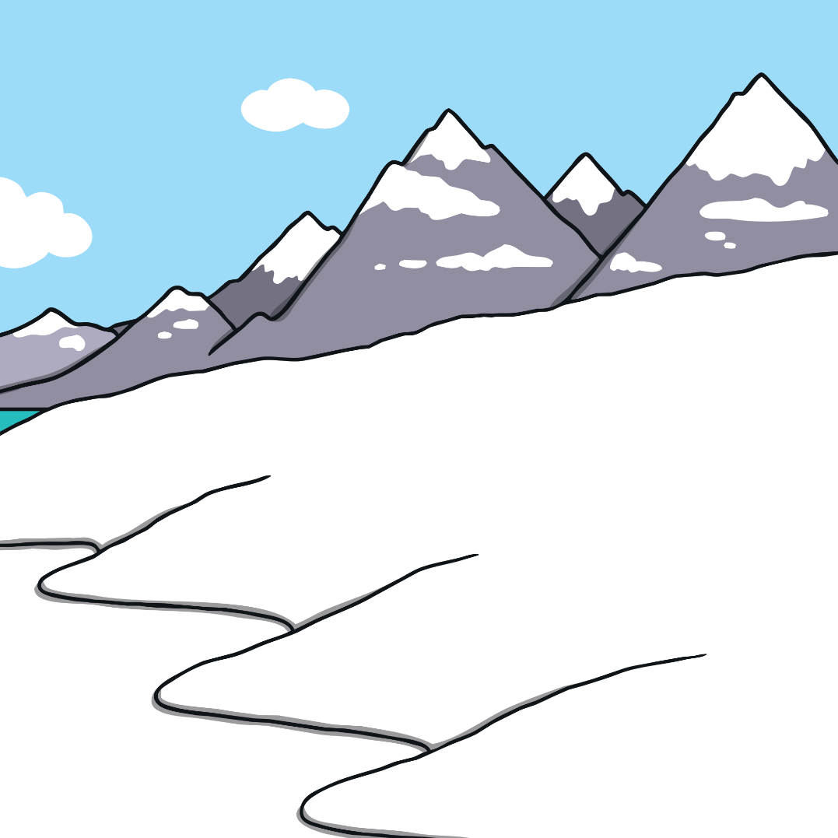
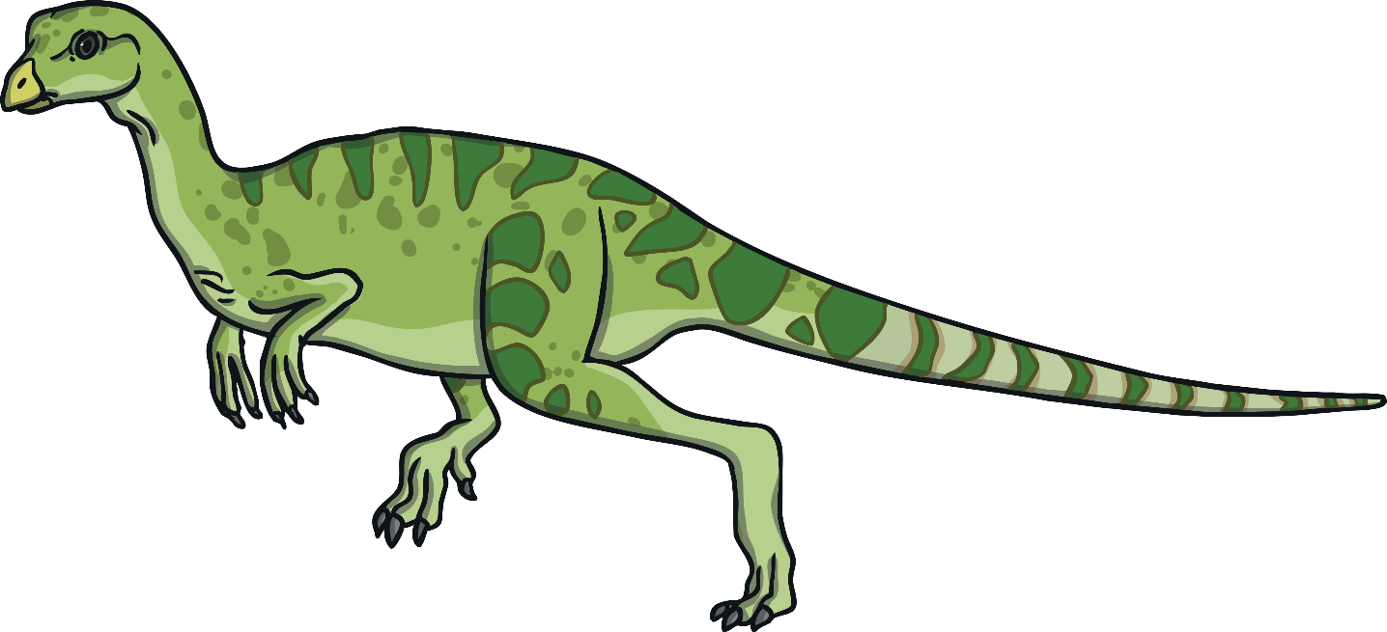
Living at the North and South Pole
The North and South Poles weren't as cold as they are today, but they had no daytime for some of the year. The dinosaurs that lived here were usually small with large eyes like the Leaellynasaura.

Slide 15
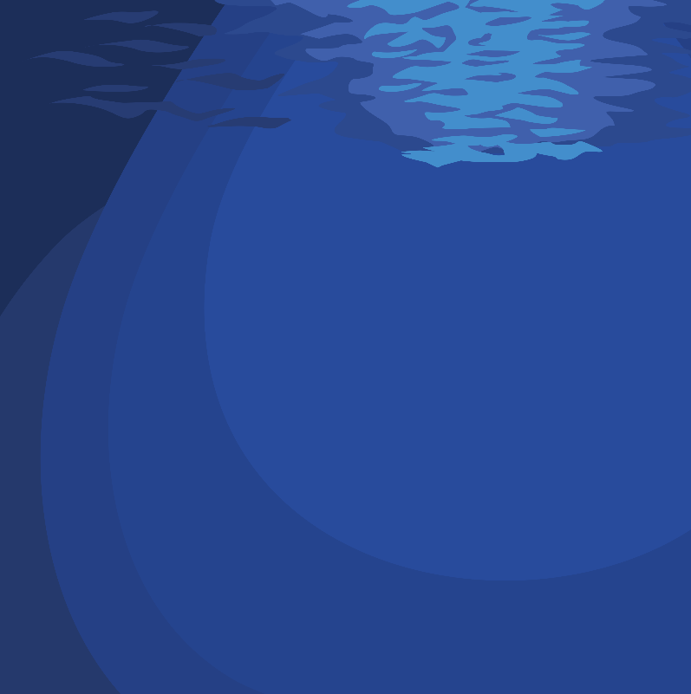
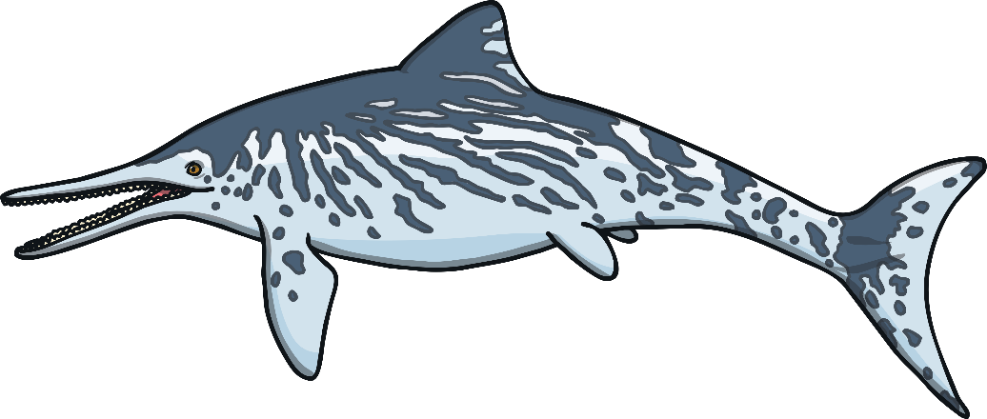
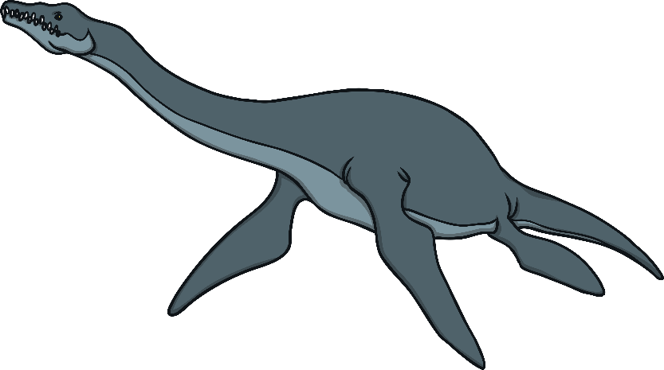
Living in the Sea
Ichthyosaurus
Plesiosaurus
There were both herbivores and carnivores that lived in the sea. Just like the other dinosaurs, their teeth suited the food they ate.

Slide 16












Can you sort these dinosaurs into herbivores carnivores and omnivores?
Click Here to Play

Slide 17

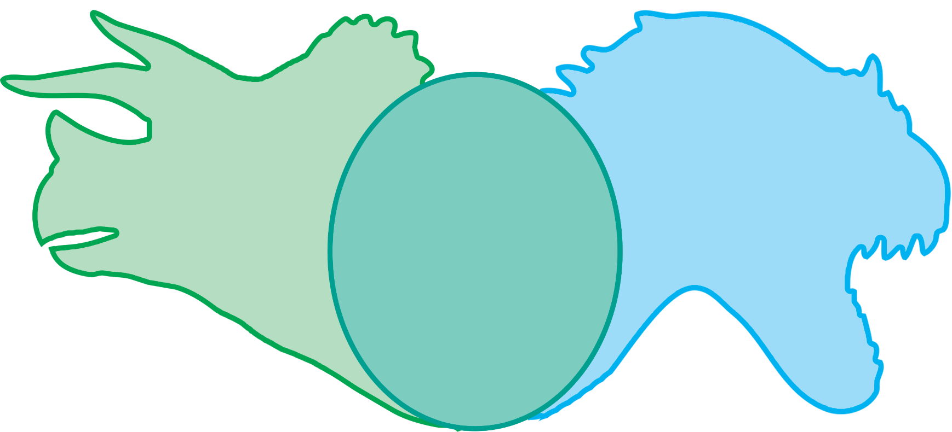
Next Question
Answer
Plesiosaur
Herbivore
Omnivore
Carnivore

Slide 18

Answer
Next Question
Brachiosaurus
Herbivore
Omnivore
Carnivore

Slide 19
Answer
Next Question
Tyrannosaurus Rex
Herbivore
Omnivore
Carnivore

Slide 20
Answer
Next Question
Stegosaurus
Herbivore
Omnivore
Carnivore

Slide 21

Answer
Next Question
Oviraptor
Herbivore
Omnivore
Carnivore

Slide 22

Answer
Next Question
Triceratops
Herbivore
Omnivore
Carnivore

Slide 23
Answer
Next Question
Apatosaurus
Herbivore
Omnivore
Carnivore

Slide 24

Answer
Next Question
Ornithomimus
Herbivore
Omnivore
Carnivore

Slide 25
Answer
Next Question
Apatosaurus
Herbivore
Omnivore
Carnivore

Slide 26

Answer
Next Question
Velociraptor
Herbivore
Omnivore
Carnivore

Slide 27

Answer
Iguanodon
Herbivore
Omnivore
Carnivore

