Slide 1

Choir Summer 2026
Music Concert
Act 1 - Opening the show
Matilda – When I grow up
Alex Warren – Carry You Home
Group 1 – Grace, Amelia, Martha and Chloe
Group 2 – Neve, Iris, Alice and Freya
Act 2 - Closing the show
Alex Warren – Ordinary
Group 1 – Anna, Poppy, Amaya and Caitlin
Matilda – Naughty

Slide 2
Matilda - When I grow up
Matilda - When I Grow Up with lyrics

Slide 3
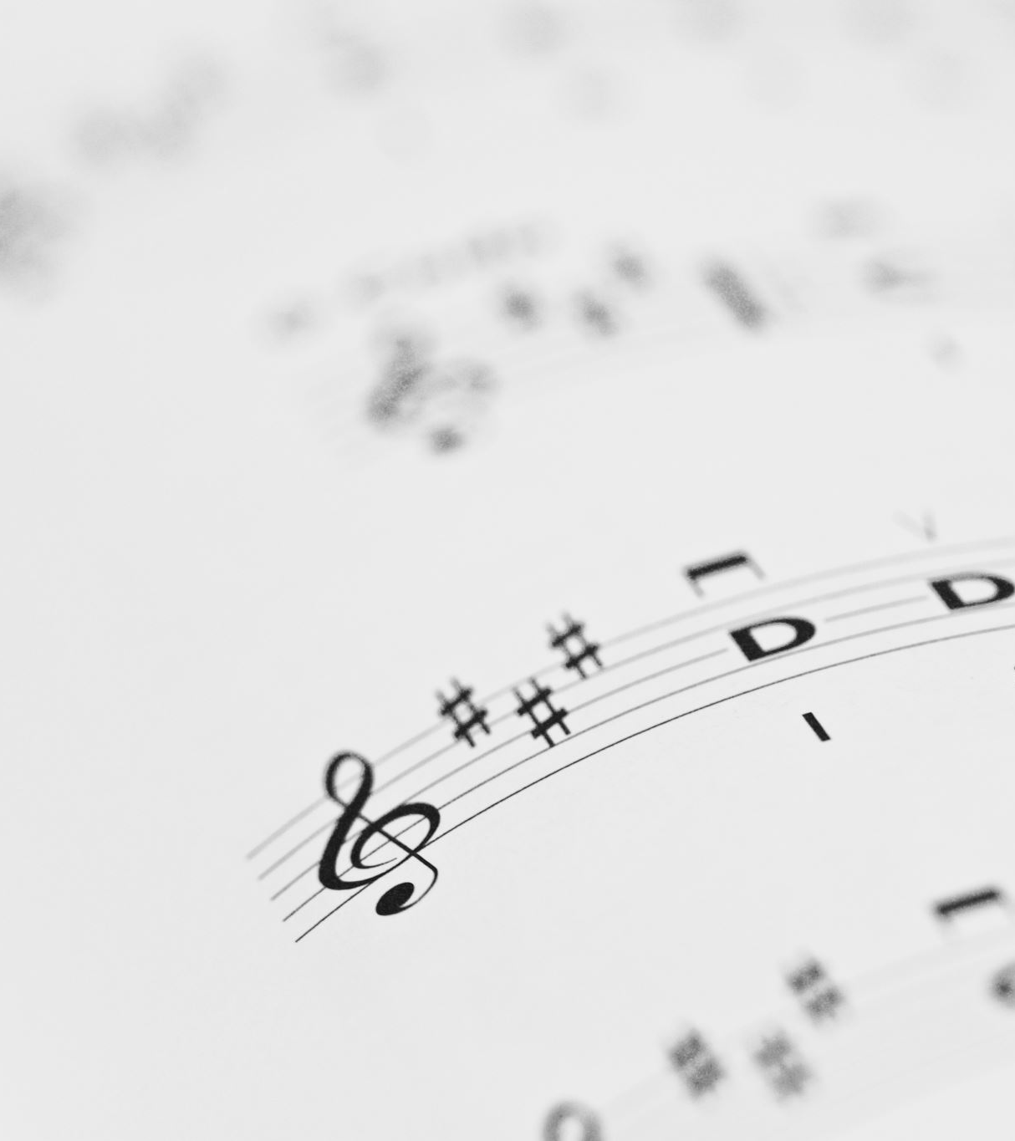
Song by Alex Warren - Carry You Home
Alex Warren - Carry You Home (Lyrics)

Slide 4
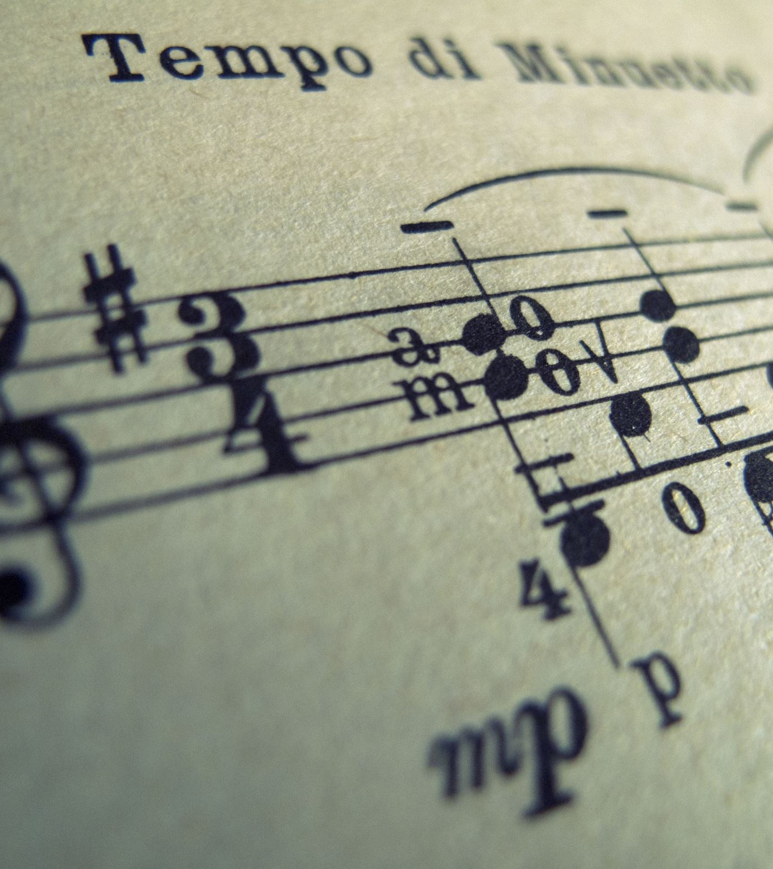
Alex Warren - ordinary
Alex Warren - Ordinary (Lyrics)

Slide 5
Matilda - Naughty
Matilda The Musical - Naughty (Lyrics) "Sometimes you have to be a little bit naughty" [TikTok Song]

