Slide 1

WORLD BOOK DAY
Book QUIZ

Slide 2
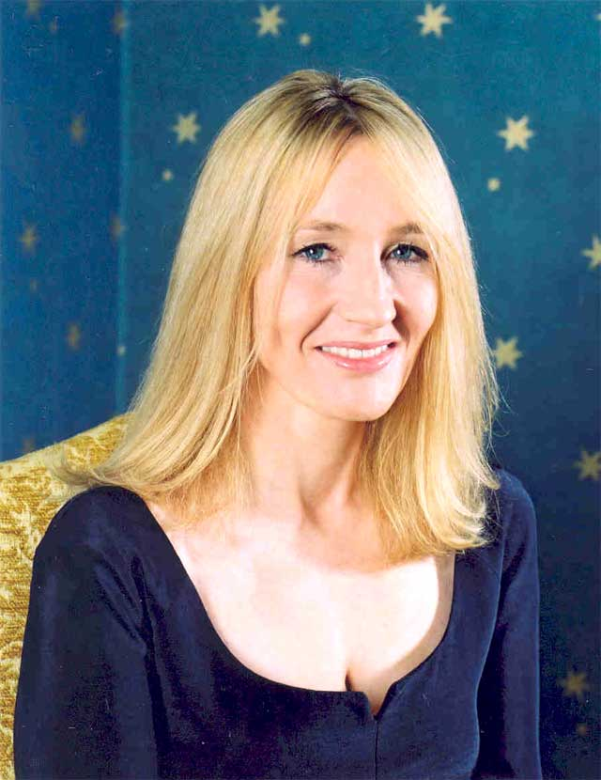
1. Who is this famous author?

Slide 3
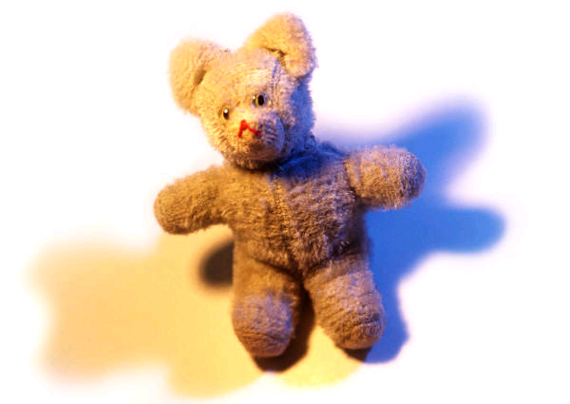
2. Which famous bear lived in Hundred Acre Wood?
A. Winnie-the-Pooh
B. Rupert
C. Paddington
D. Yogi

Slide 4
3. What is the name of Mr Filch’s cat in Harry Potter?
A. Mrs Lorris
B. Mrs Morris
C. Mrs Doris
D. Mrs Norris

Slide 5
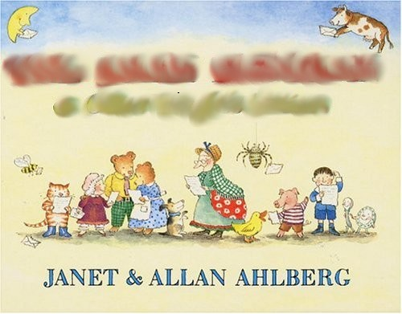
4. This is the front cover of which children’s book?

Slide 6
5. The book ‘The Sheep Pig’ by Dick King Smith was turned into which blockbuster film?

Slide 7

6. This is the front cover of which book?

Slide 8
7. What did Jack NOT steal from the giant in ‘Jack and the Beanstalk’?
A. A bag of gold.
B. A golden fleece
C. A golden harp.
D. A goose that laid golden eggs.

Slide 9
8. Which of the following books has NOT been turned into a film yet?
‘Matilda’
‘The Lion the Witch and the Wardrobe’
‘Charlie and the great glass elevator’

Slide 10

9. Which children’s book character is this?

Slide 11
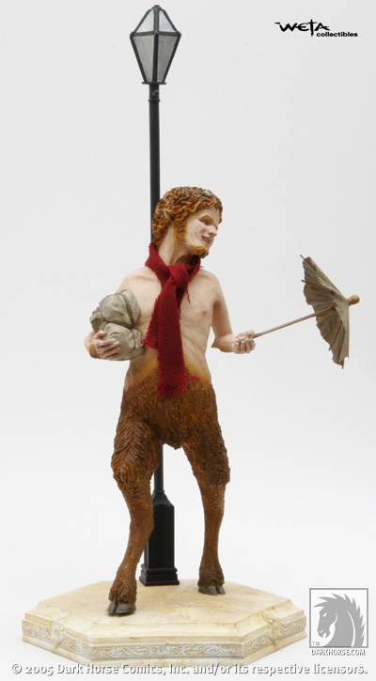
10. What was the name of this character in ‘The Lion, The Witch and The Wardrobe’?

Slide 12
11. What was the first children’s book Roald Dahl ever wrote?

Slide 13
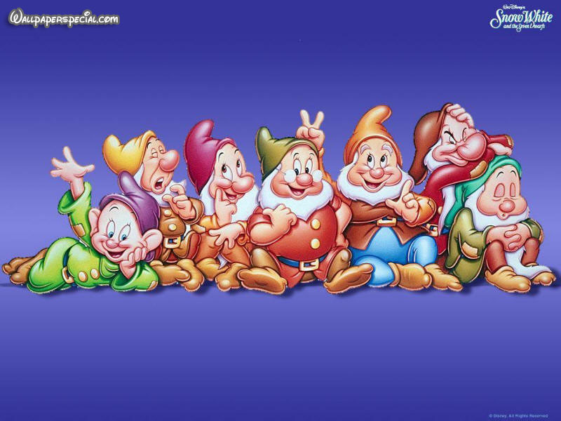
12. Name all of Snow White’s Seven Dwarfs. (One point for each!)

Slide 14
World Book Day Quiz
2021
ANSWERS

Slide 15
1. Who is this famous author?
JK Rowling

Slide 16
2. Which famous bear lived in Hundred Acre Wood?
A. Winnie-the-Pooh
B. Rupert
C. Paddington
D. Yogi

Slide 17
3. What is the name of Mr Filch’s cat in Harry Potter?
A. Mrs Lorris
B. Mrs Morris
C. Mrs Doris
D. Mrs Norris

Slide 18
4. This is the front cover of which children’s book?
The Jolly Postman

Slide 19
5. The book ‘The Sheep Pig’ by Dick King Smith was turned into which blockbuster film? Babe

Slide 20
6. This is the front cover of which book?
Head Kid

Slide 21
7. What did Jack NOT steal from the giant in ‘Jack and the Beanstalk’?
A. A bag of gold.
B. A golden fleece
C. A golden harp.
D. A goose that laid golden eggs.

Slide 22
8. Which of the following books has NOT been turned into a film yet?
‘Matilda’
‘The Lion the Witch and the Wardrobe’
‘Charlie and the great glass elevator’

Slide 23
9. Which children’s book character is this? Elmer

Slide 24
10. What was the name of this character in ‘The Lion, The Witch and The Wardrobe’?
Mr Tumnus

Slide 25
11. What was the first children’s book Roald Dahl ever wrote?
James and the Giant Peach

Slide 26
12. Name all of Snow White’s Seven Dwarfs. (One point for each!) Doc, Grumpy, Happy, Sleepy, Dopey, Bashful, Sneezy

