Slide 1
BOOK TABOO
Split into two teams. Team one will go first. You must choose one player to sit in front of the white board. You must get them to guess the word on the top of the screen. You are not allowed to say any of the clue words, any names, do any actions, get out of your seat or make any sound effects! The words will be book titles, characters, genres, authors, etc.
Remember you can’t say any names
That means no names of authors, books, characters, etc!
GOOD LUCK

Slide 2
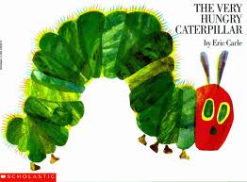
Clue Words:
The Very Hungry Caterpillar
Butterfly, Insect

Slide 3
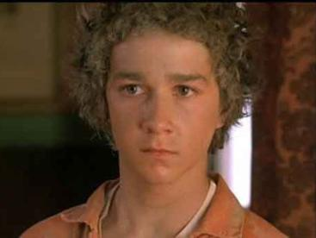
Clue Words:
STANLEY YELNATS
Lizards, Digging

Slide 4
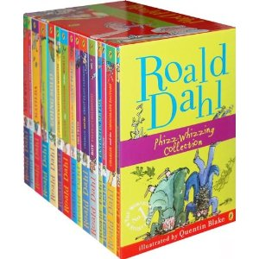
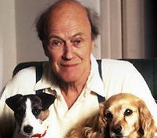
Clue Words:
Roald Dahl
Author

Slide 5

Clue Words:
Harry Potter
Magic, Wizard

Slide 6
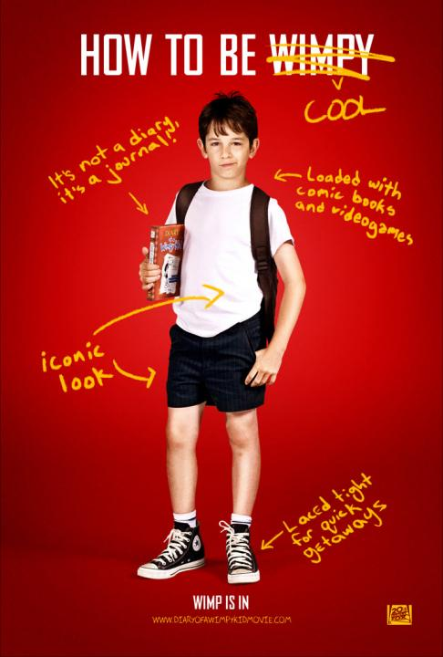
Clue Words:
Jeff Kinney
Diary, middle-school

Slide 7

Clue Words:
The Lion, The Witch and The Wardrobe
Cupboard, Lion, film

Slide 8
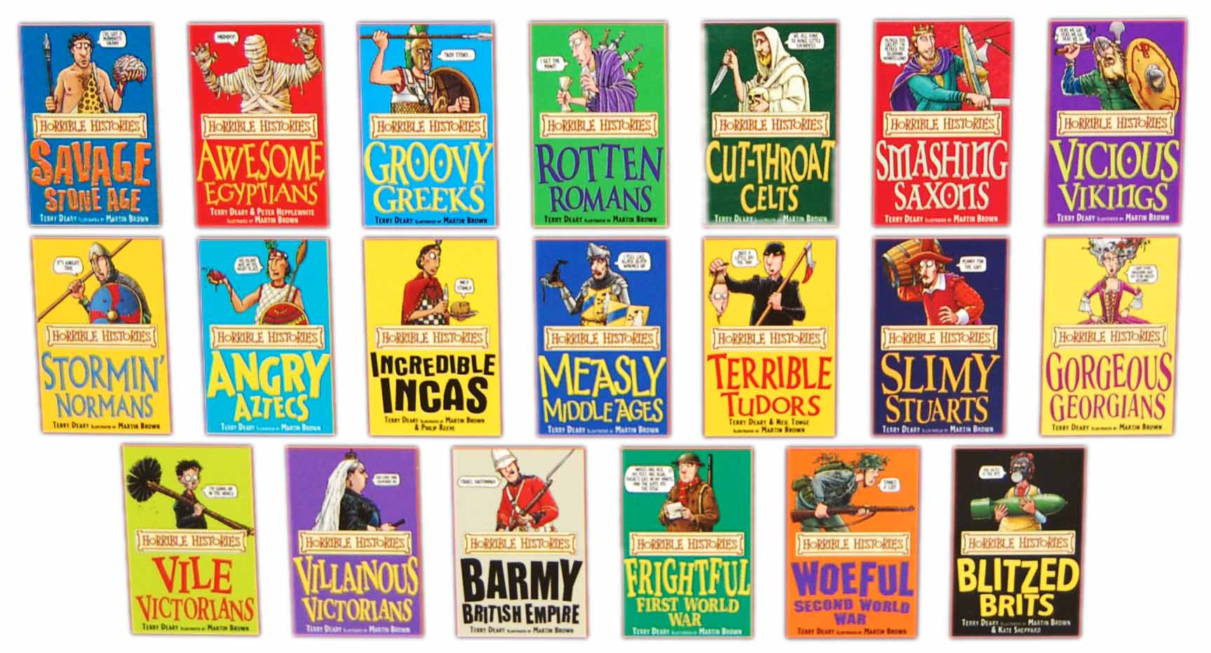
Clue Words:
Horrible Histories
History, Romans, Tudors, gruesome deaths

Slide 9
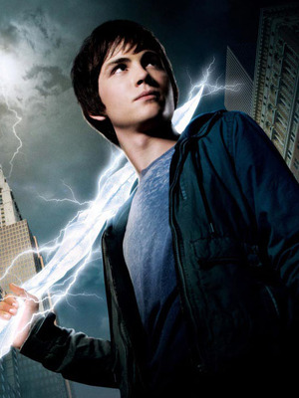
Clue Words:
Percy Jackson
Gods, Lightning

Slide 10

Clue Words:
Poetry
Rhymes, Slam

Slide 11
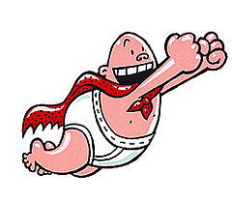
Clue Words:
Captain Underpants
Pants, boxers, baby, toilets

Slide 12
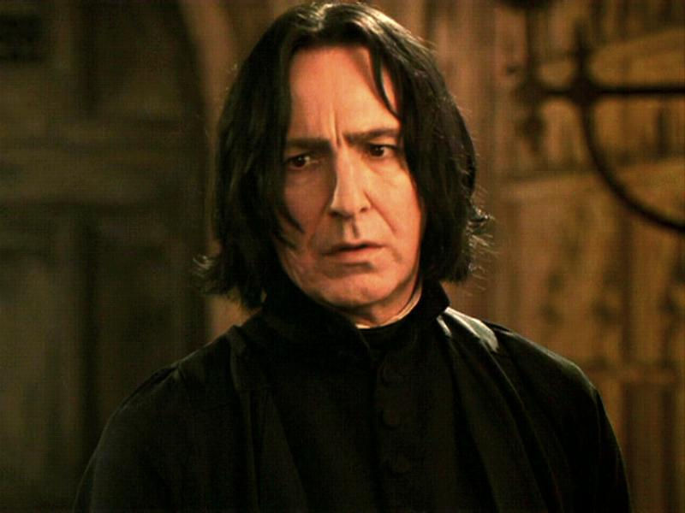
Clue Words:
Snape
Magic, Wizard

Slide 13
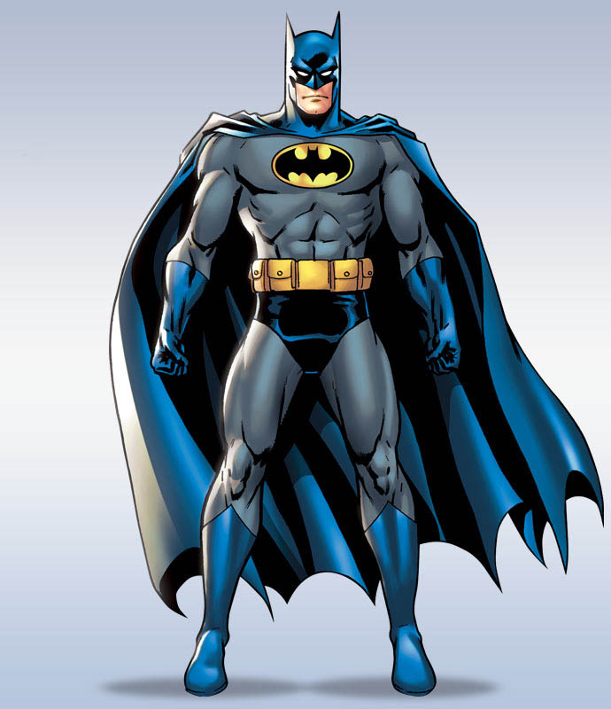
Clue Words:
Batman
Bat, Man, Superhero

Slide 14
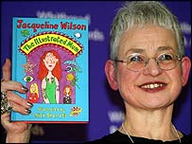
Clue Words:
Jacqueline Wilson
Author

Slide 15

Clue Words:
Romance
Love, Girls

Slide 16

Clue Words:
The Cat in the Hat
Thing, Miaow

Slide 17
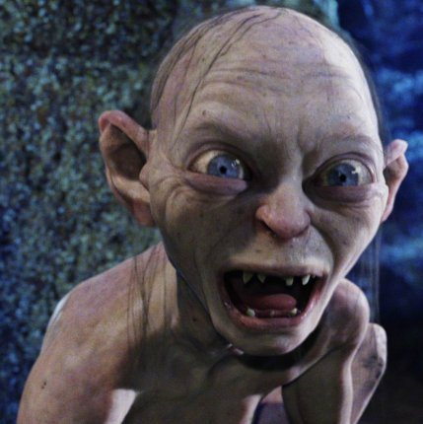
Clue Words:
Gollum
Precious, Ring

Slide 18
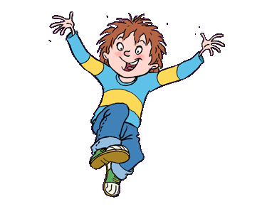
Clue Words:
Horrid Henry
Naughty, Boy

Slide 19
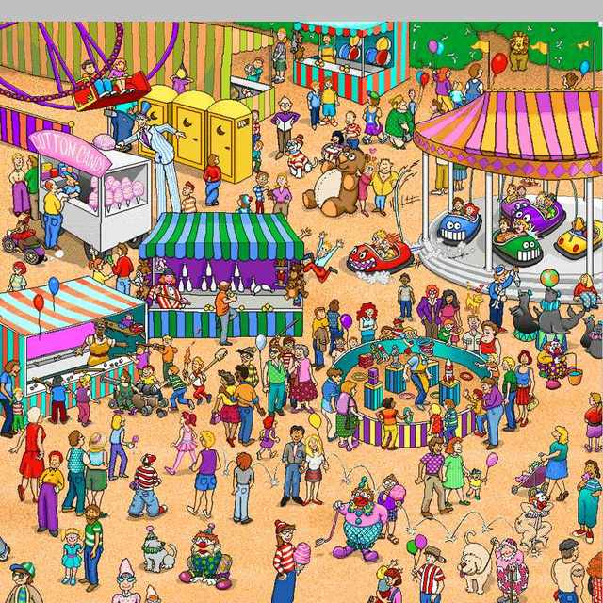
Clue Words:
Where’s Wally
Stripe, Find, Search

Slide 20

Clue Words:
Guinness World Records
Biggest, Longest, Tallest, Oldest

Slide 21

Clue Words:
The Rainbow Fish
Children’s, Primary, Fish

Slide 22
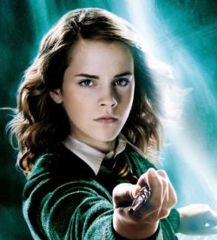
Clue Words:
Hermione
Clever, Witch, Wizard

